Slide 1

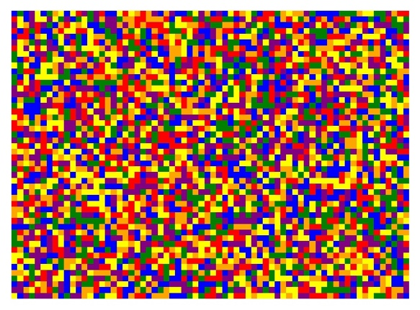

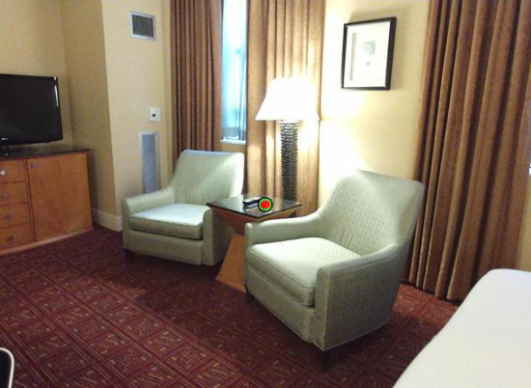
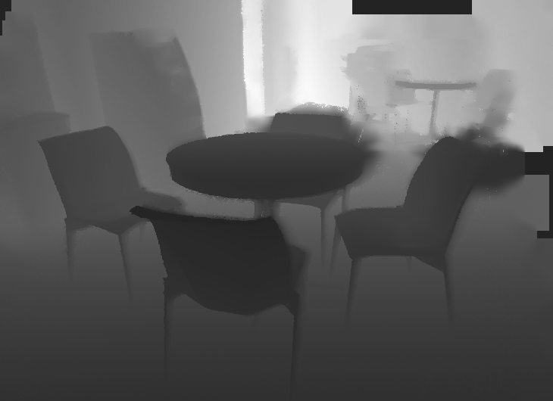
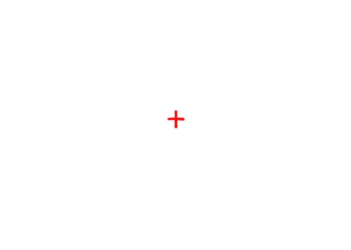
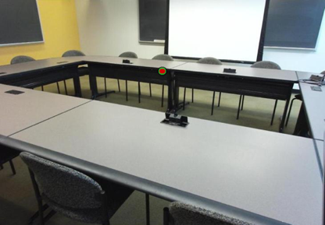

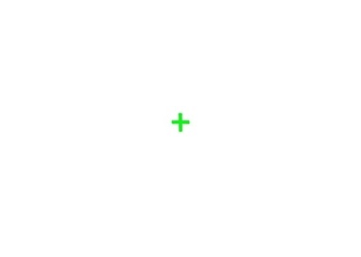
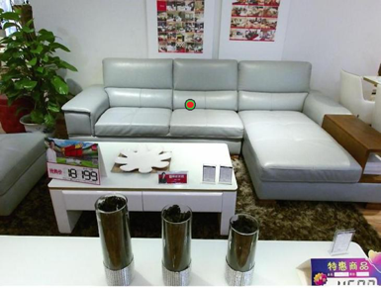

A.
B.
How far away was the target, in meters?
Target Image
125, 250, or 1000 ms
500 ms
time
- 0.25 m
500 ms
Depth Image
- 2.6 m
- 5 m
C.
Respond which target was closer
125, 250, or 1000 ms
500 ms
time
500 ms
500 ms
500 ms
125, 250, or 1000 ms
500 ms
Figure 1. Behavioral Paradigms. A) Sample target image and corresponding SUN-RGBD depth map. B) Metric estimate paradigm. Scenes with embedded targets were presented for a variable duration followed by a mask. C) Distance discrimination paradigm. Participants were presented with two scenes for the same duration and responded which target was closer.
Notes:
DONE

Slide 2
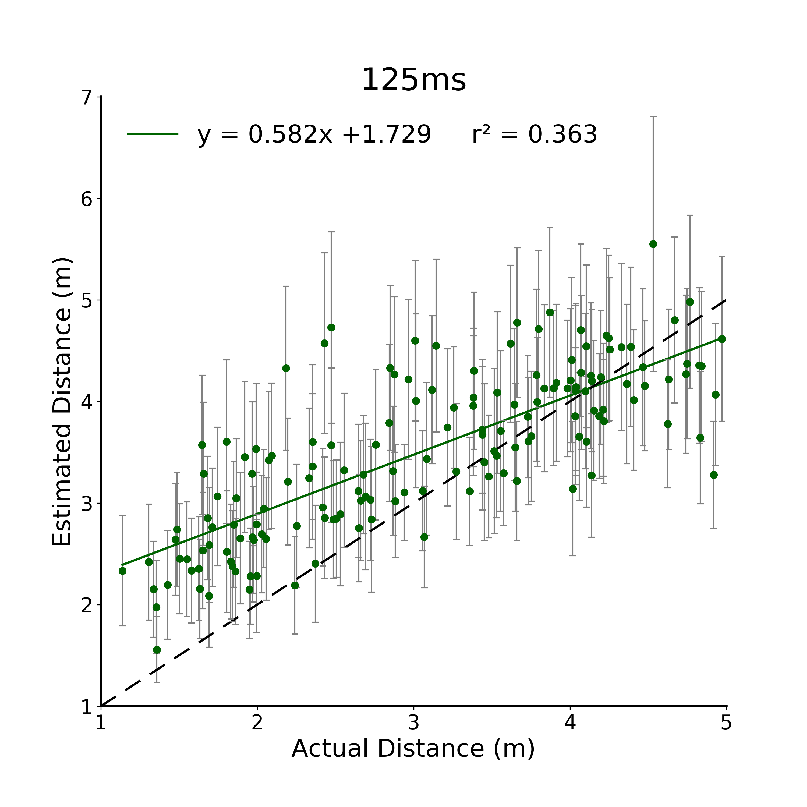
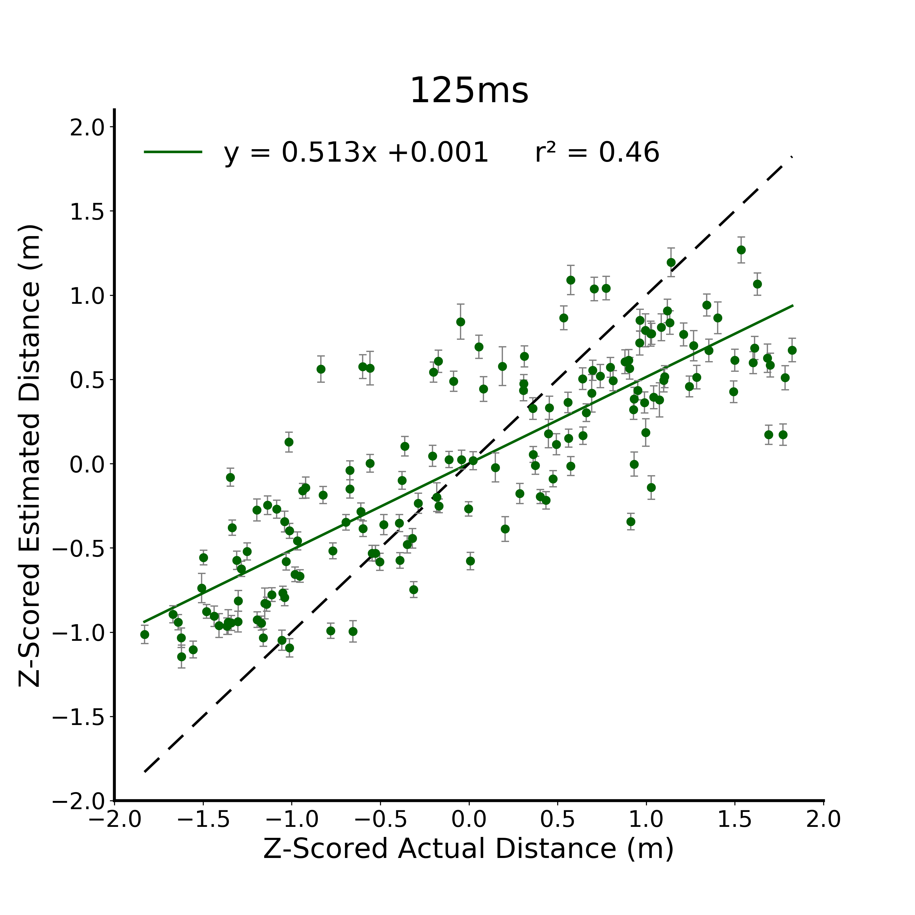
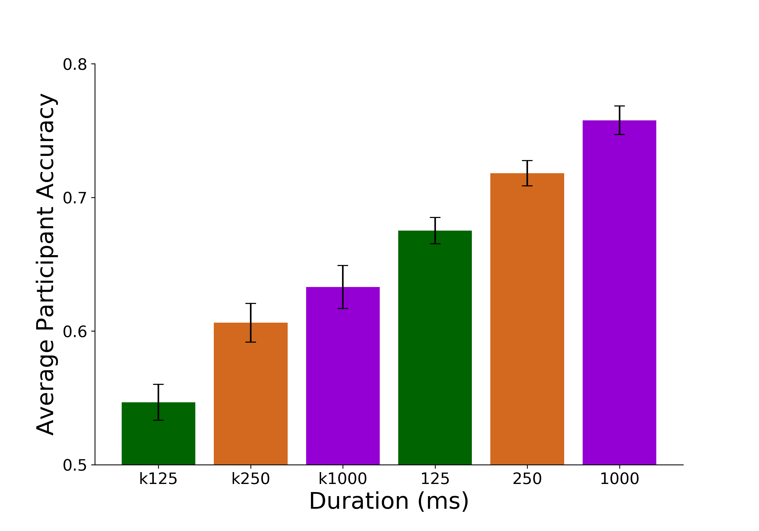
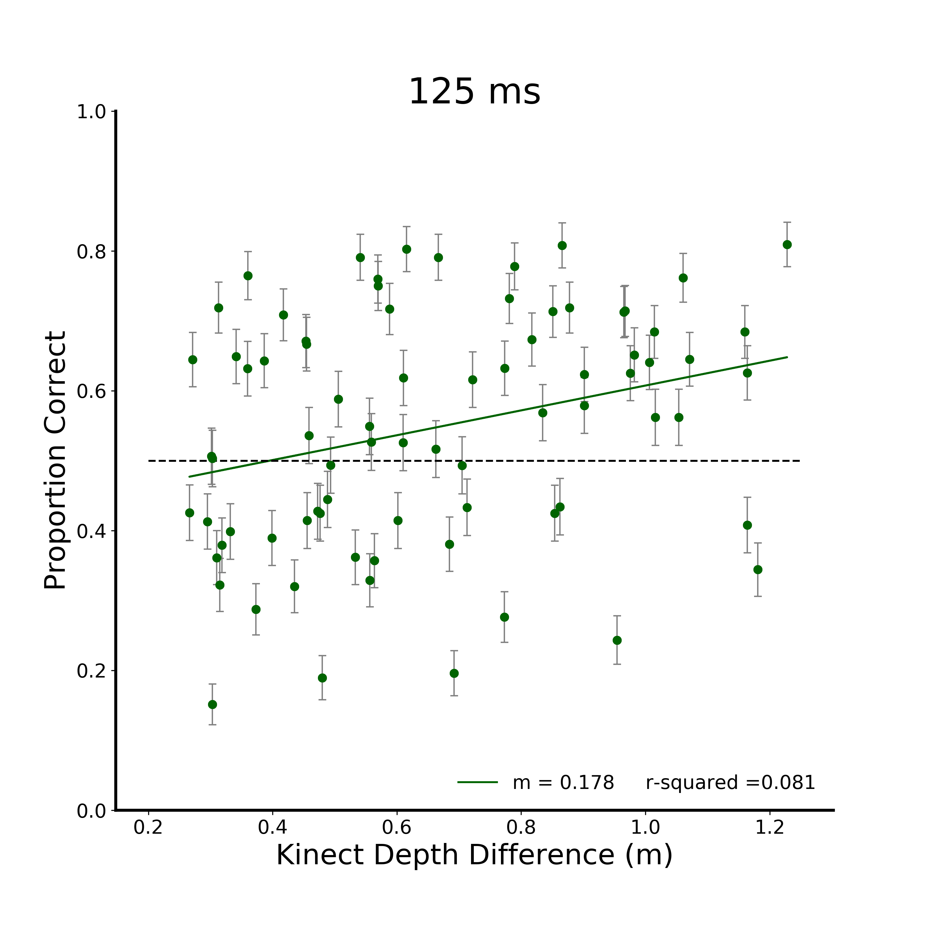
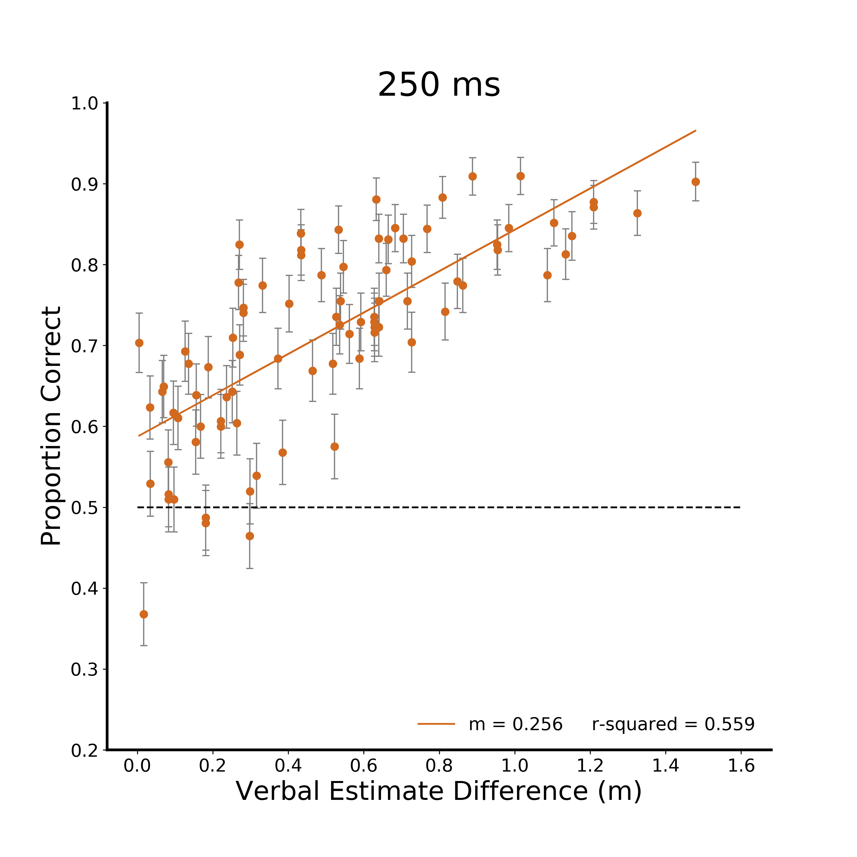
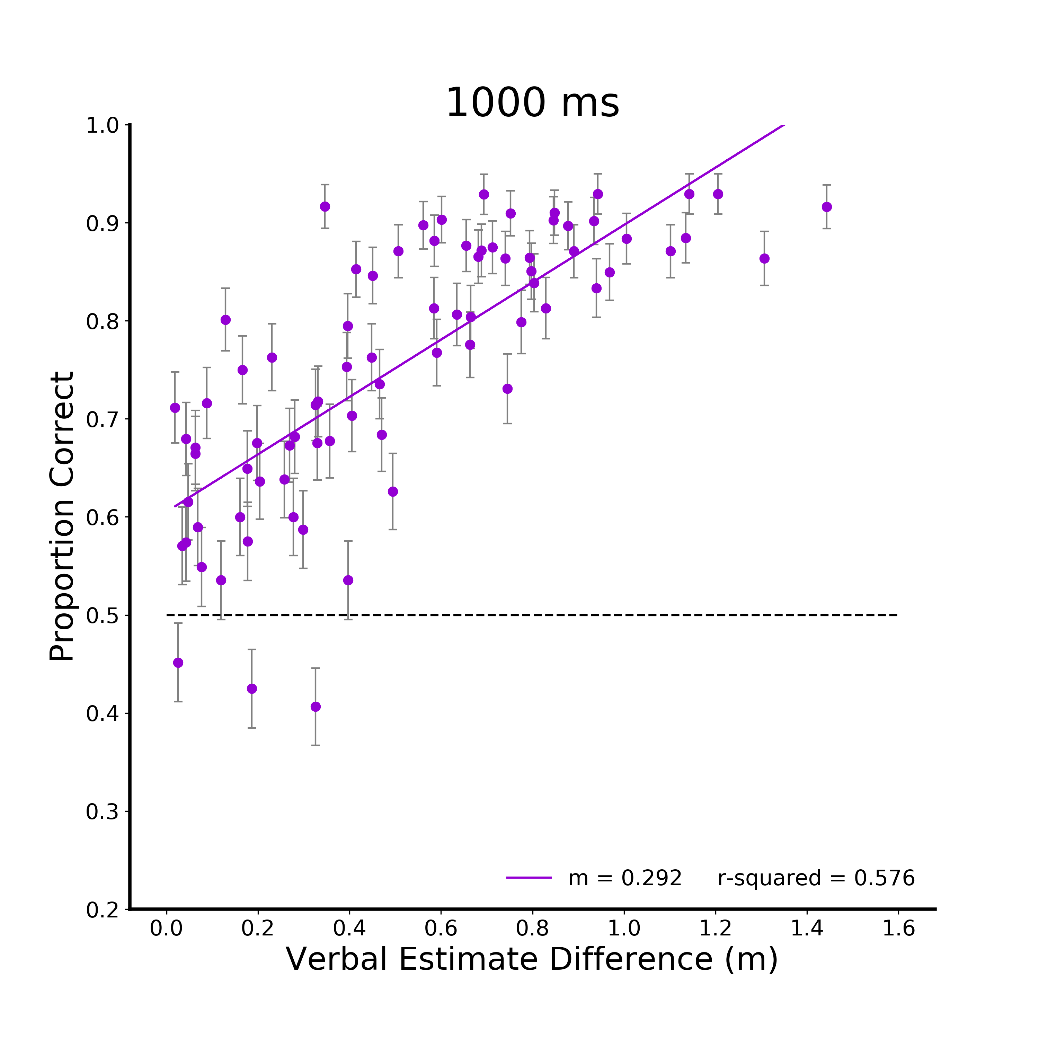
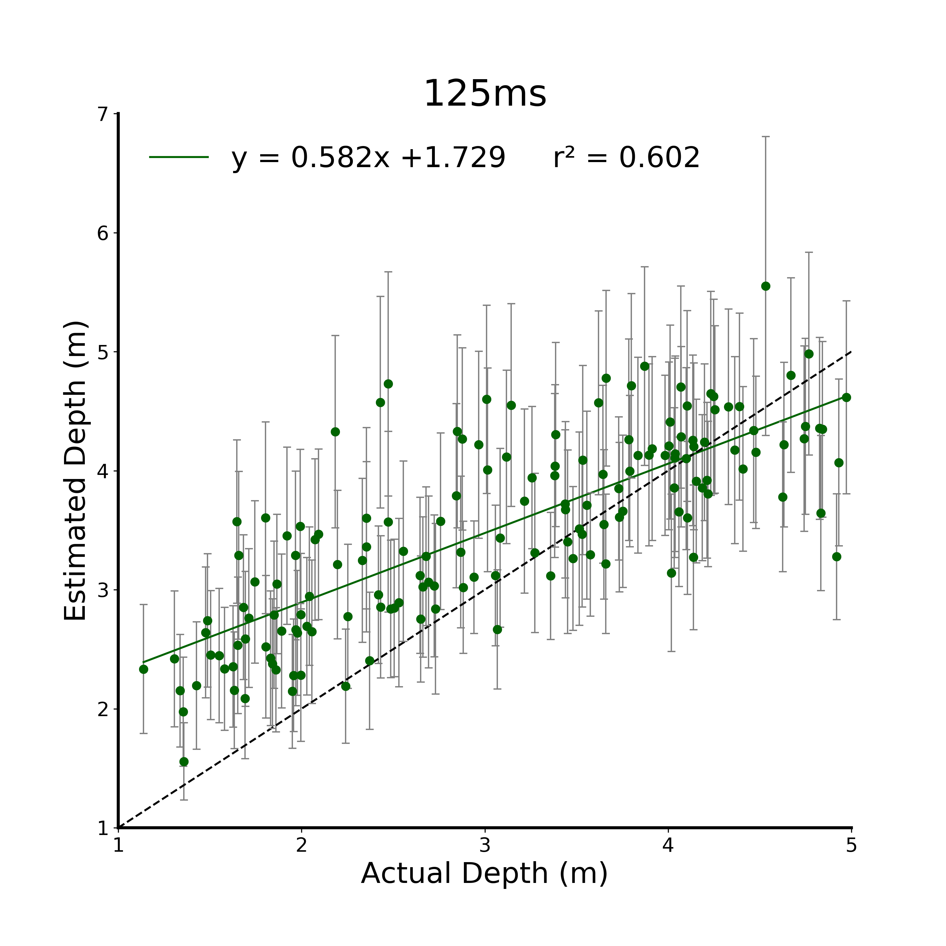
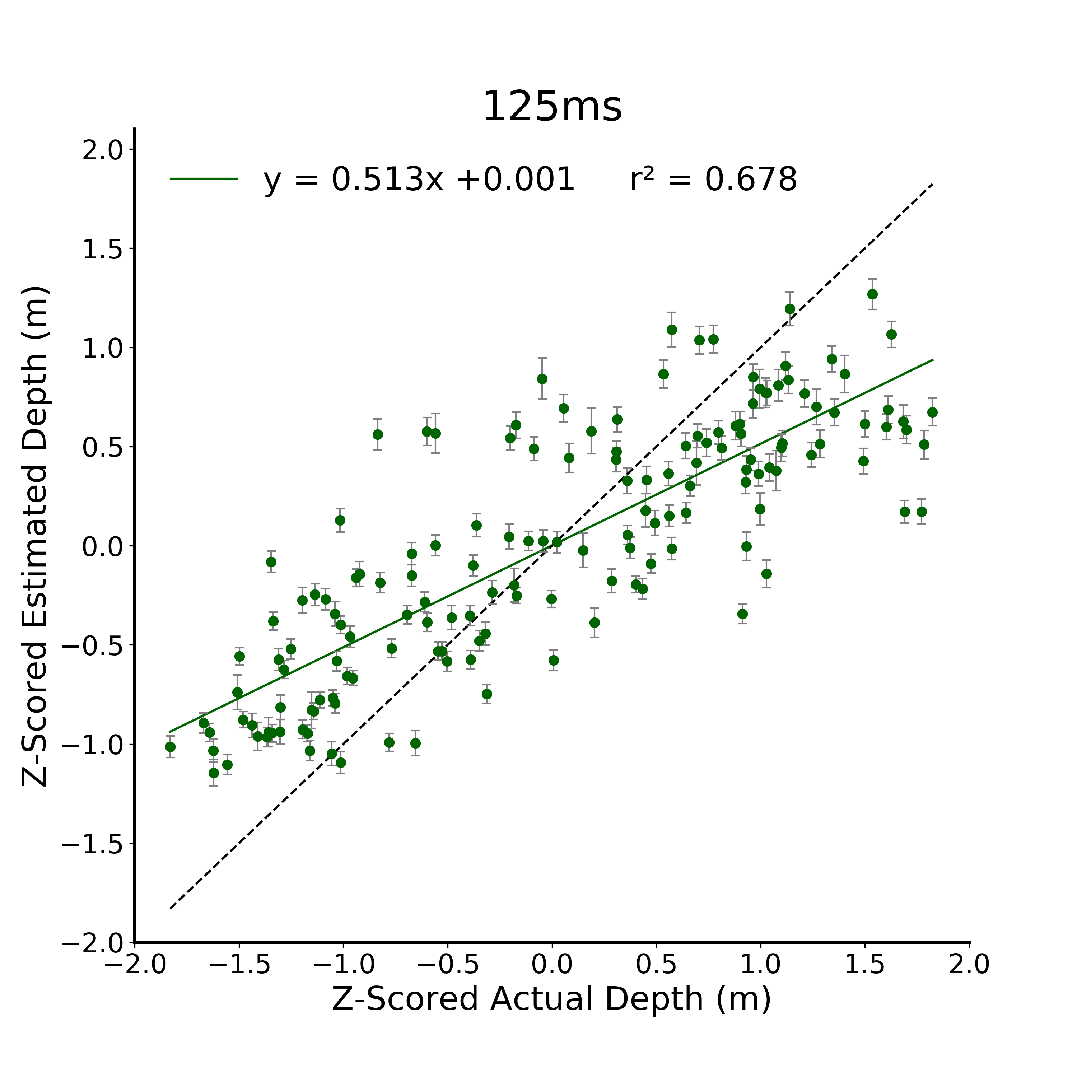

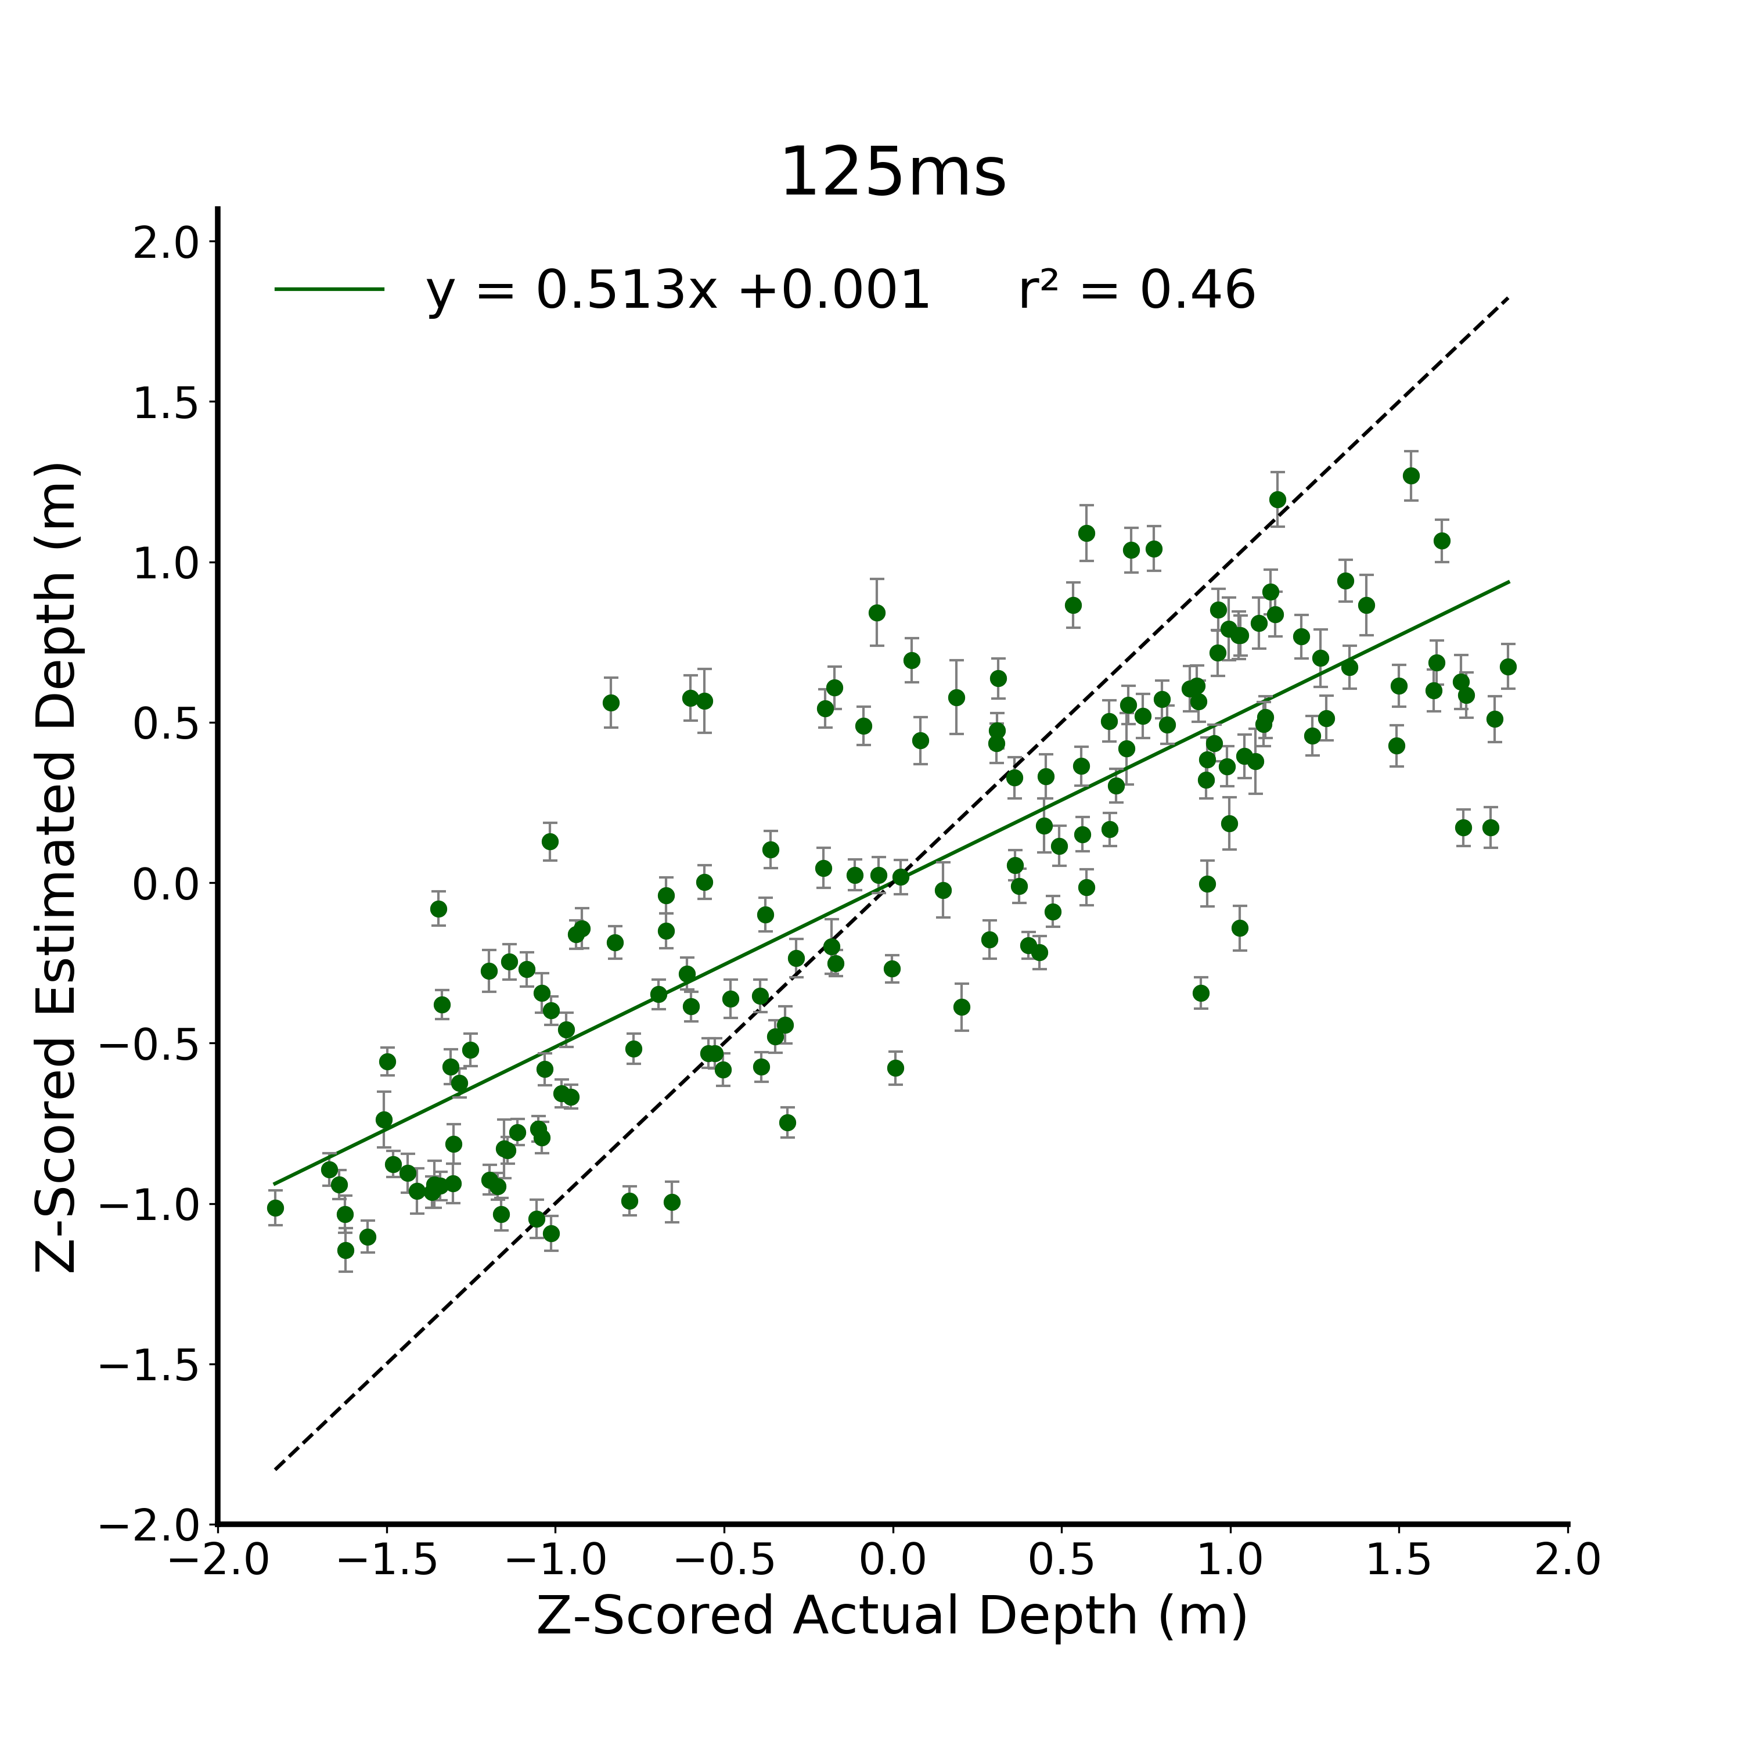
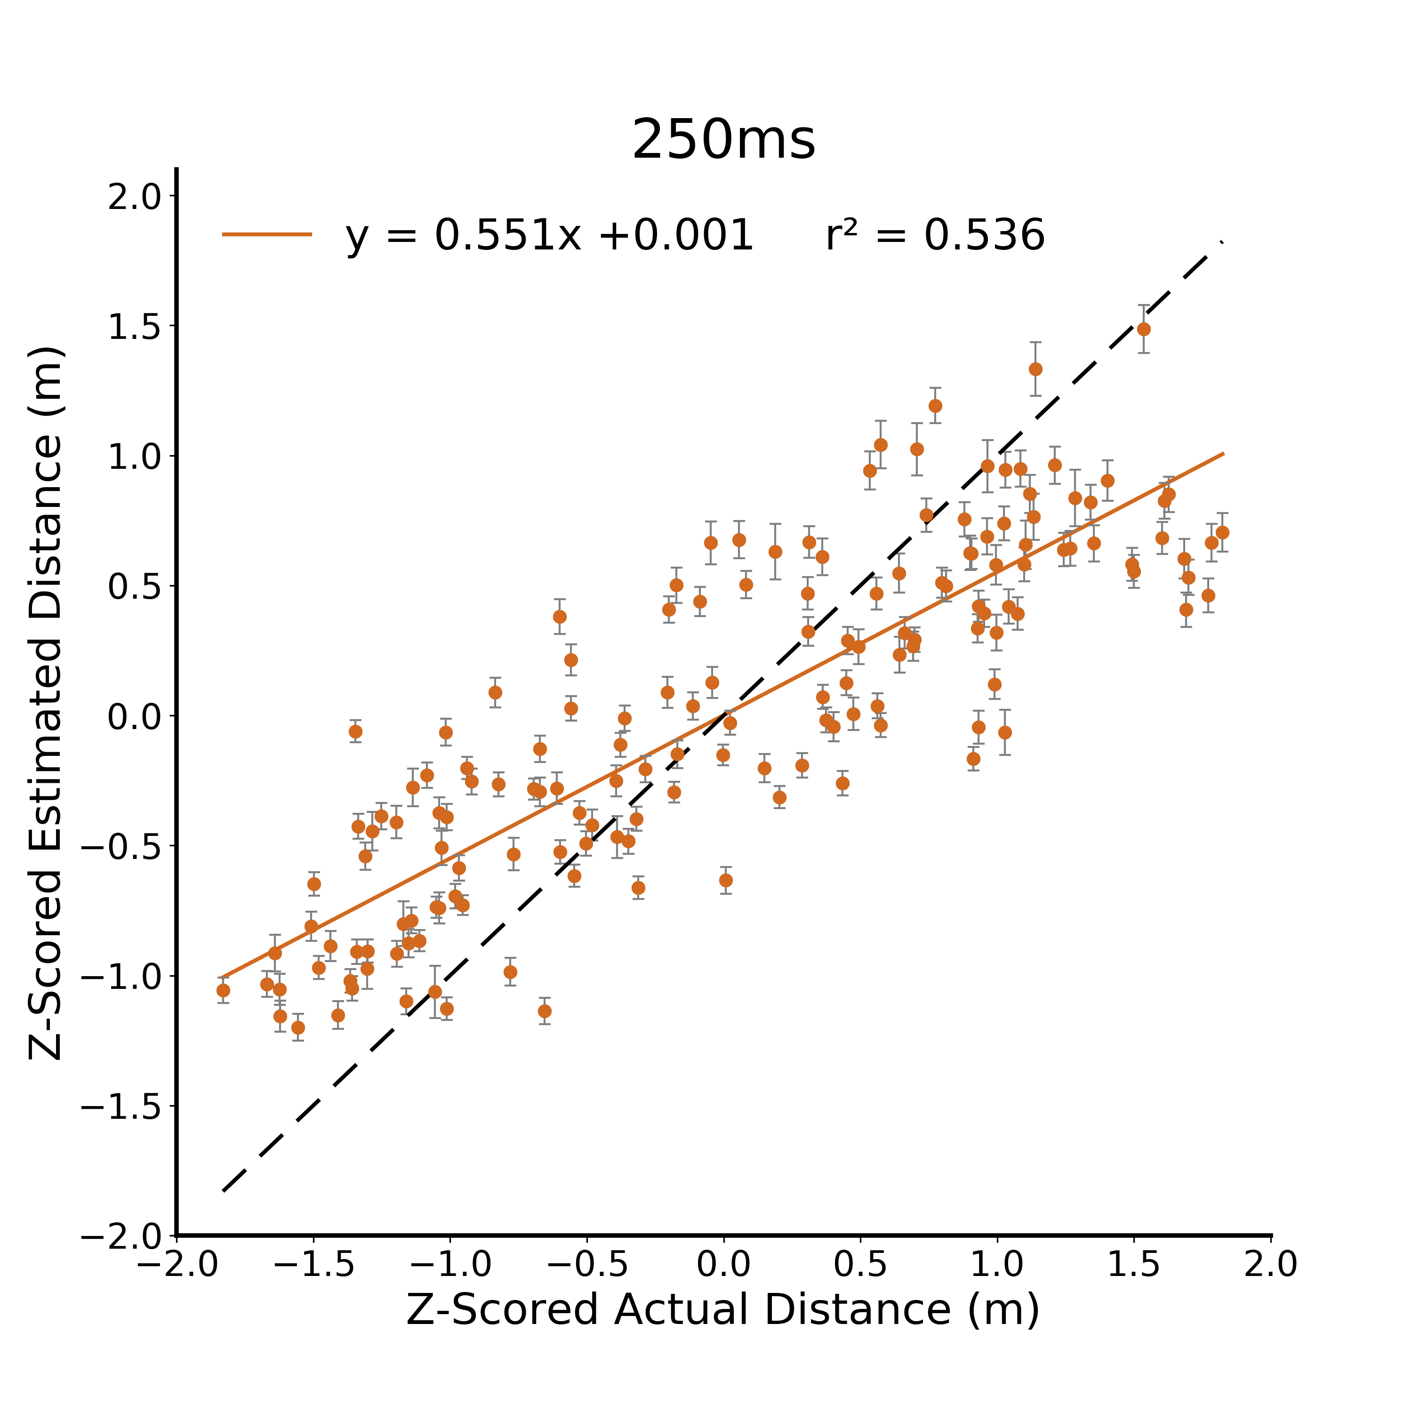
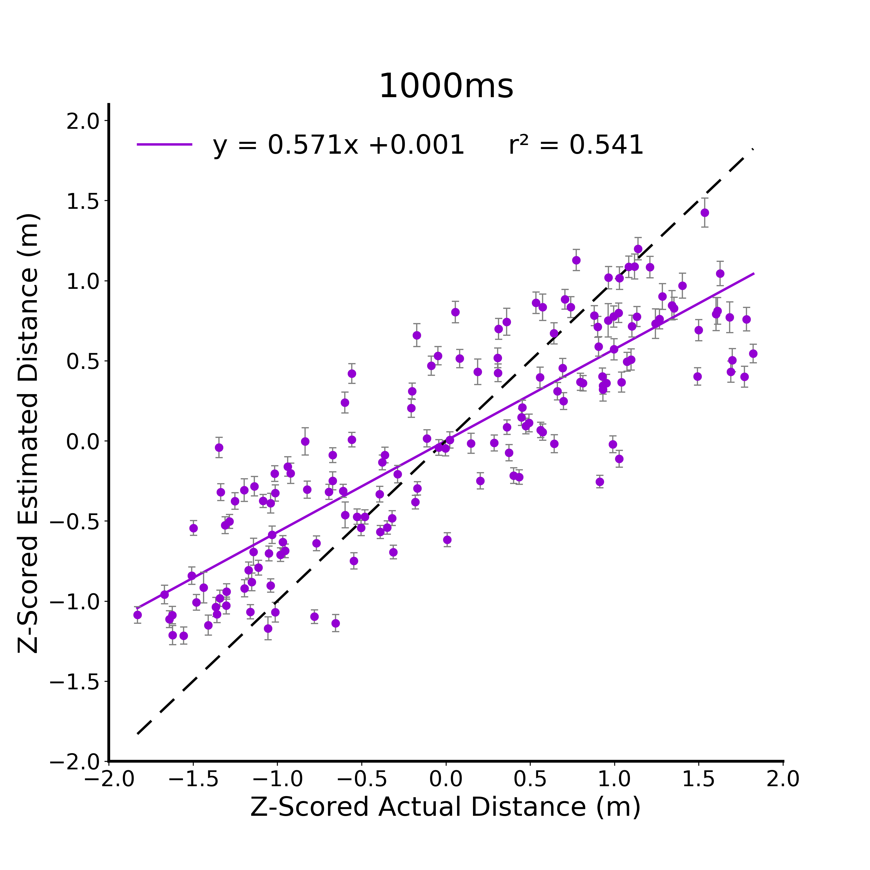

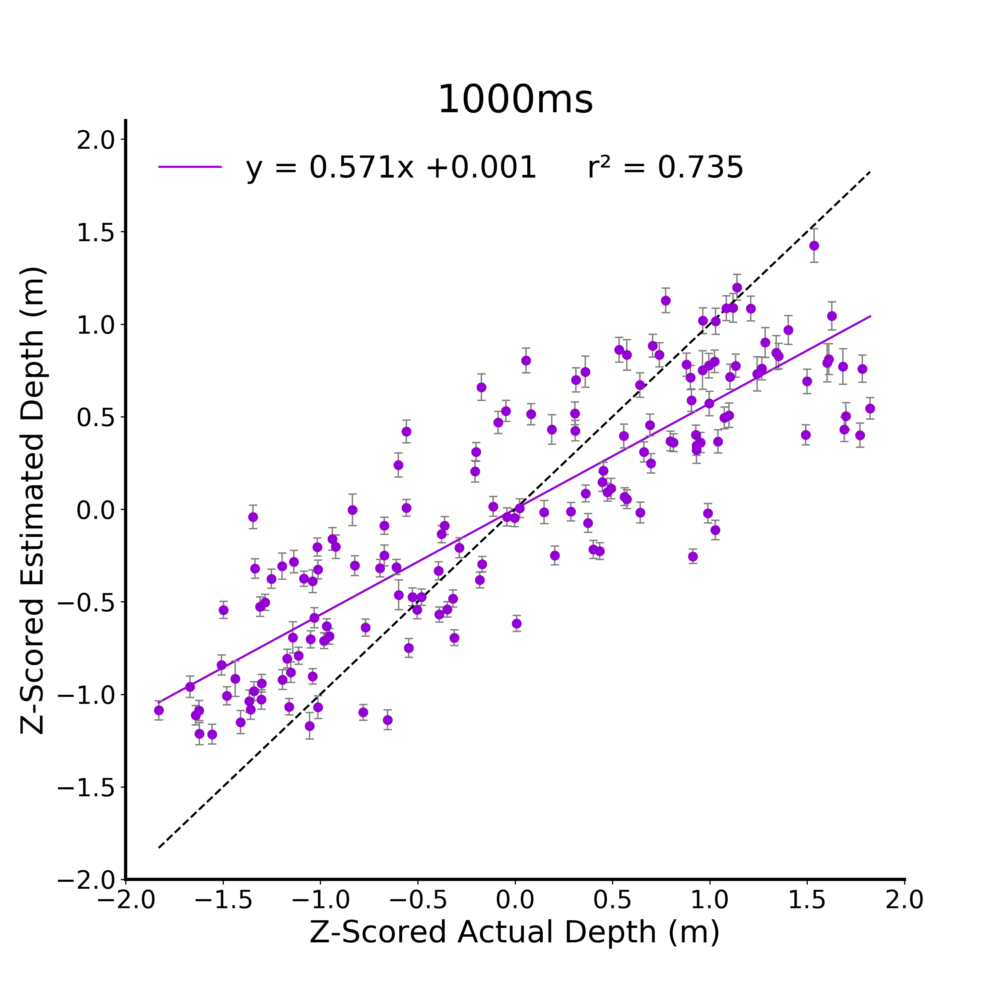


A.
B.
C.
D.
Figure 2. Metric Estimate Linear Models. A) Raw data from the metric estimate task for the 125 ms viewing duration condition. Participants are independent between viewing duration conditions and all error bars in plots are between subjects standard error. B) Z-scored data at 125ms. C) Z-scored data at 250ms. D) Z-scored data at 1000ms.
Notes:
DONE

Slide 3
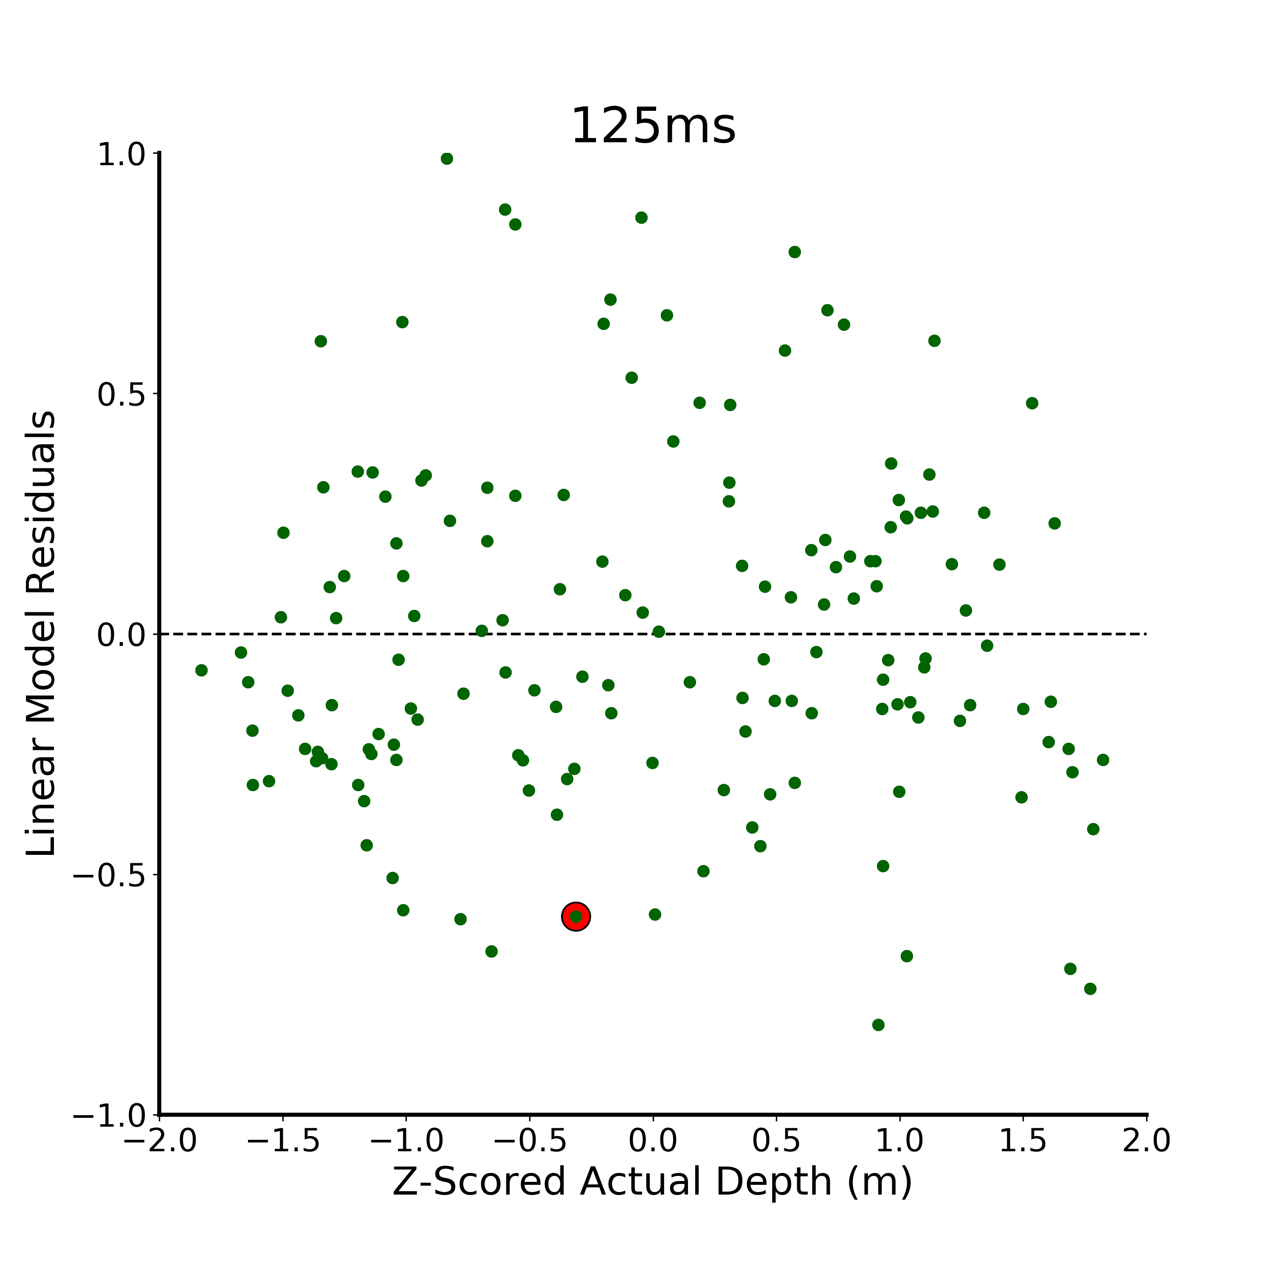
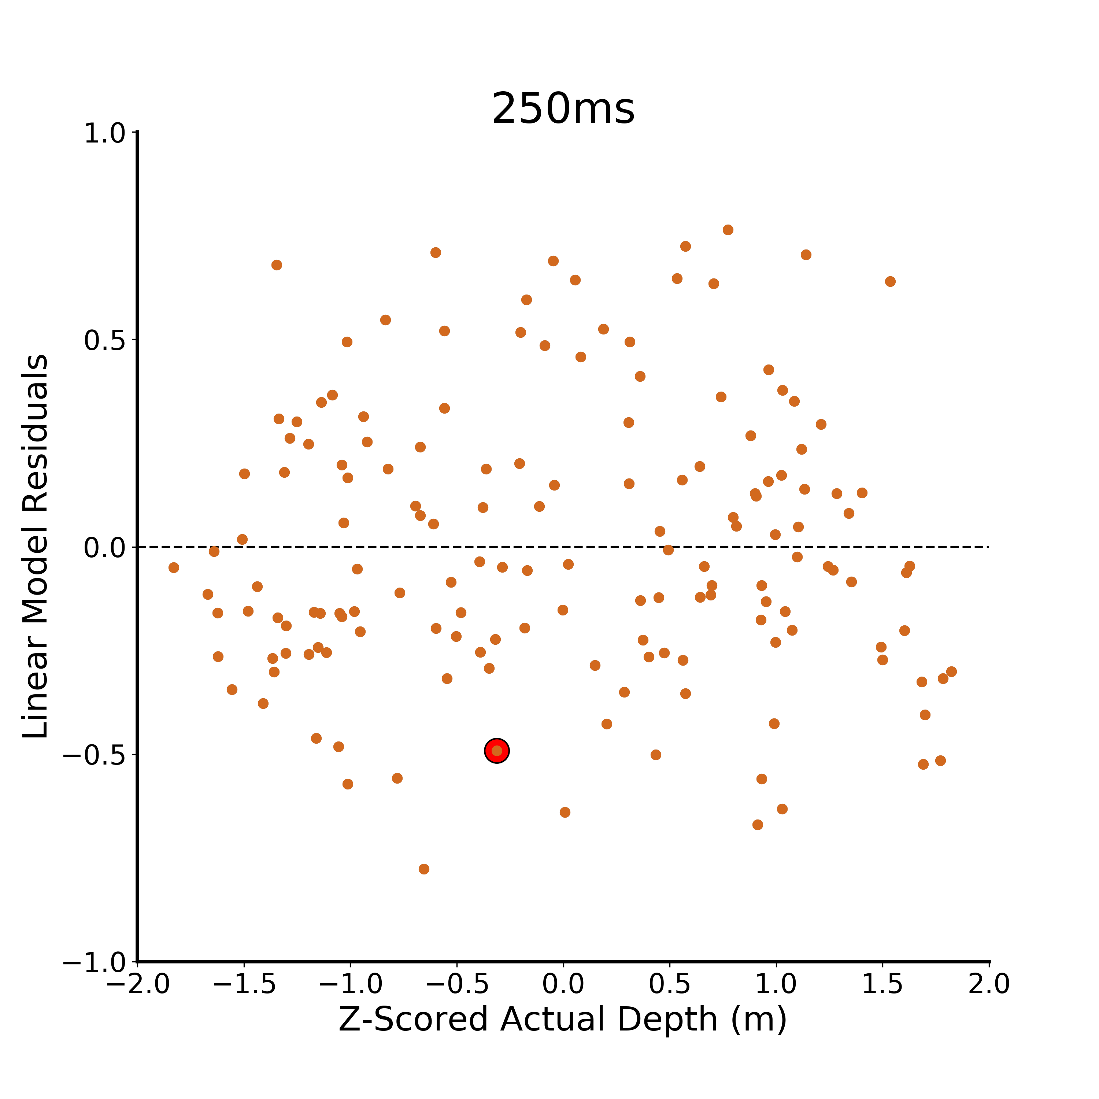
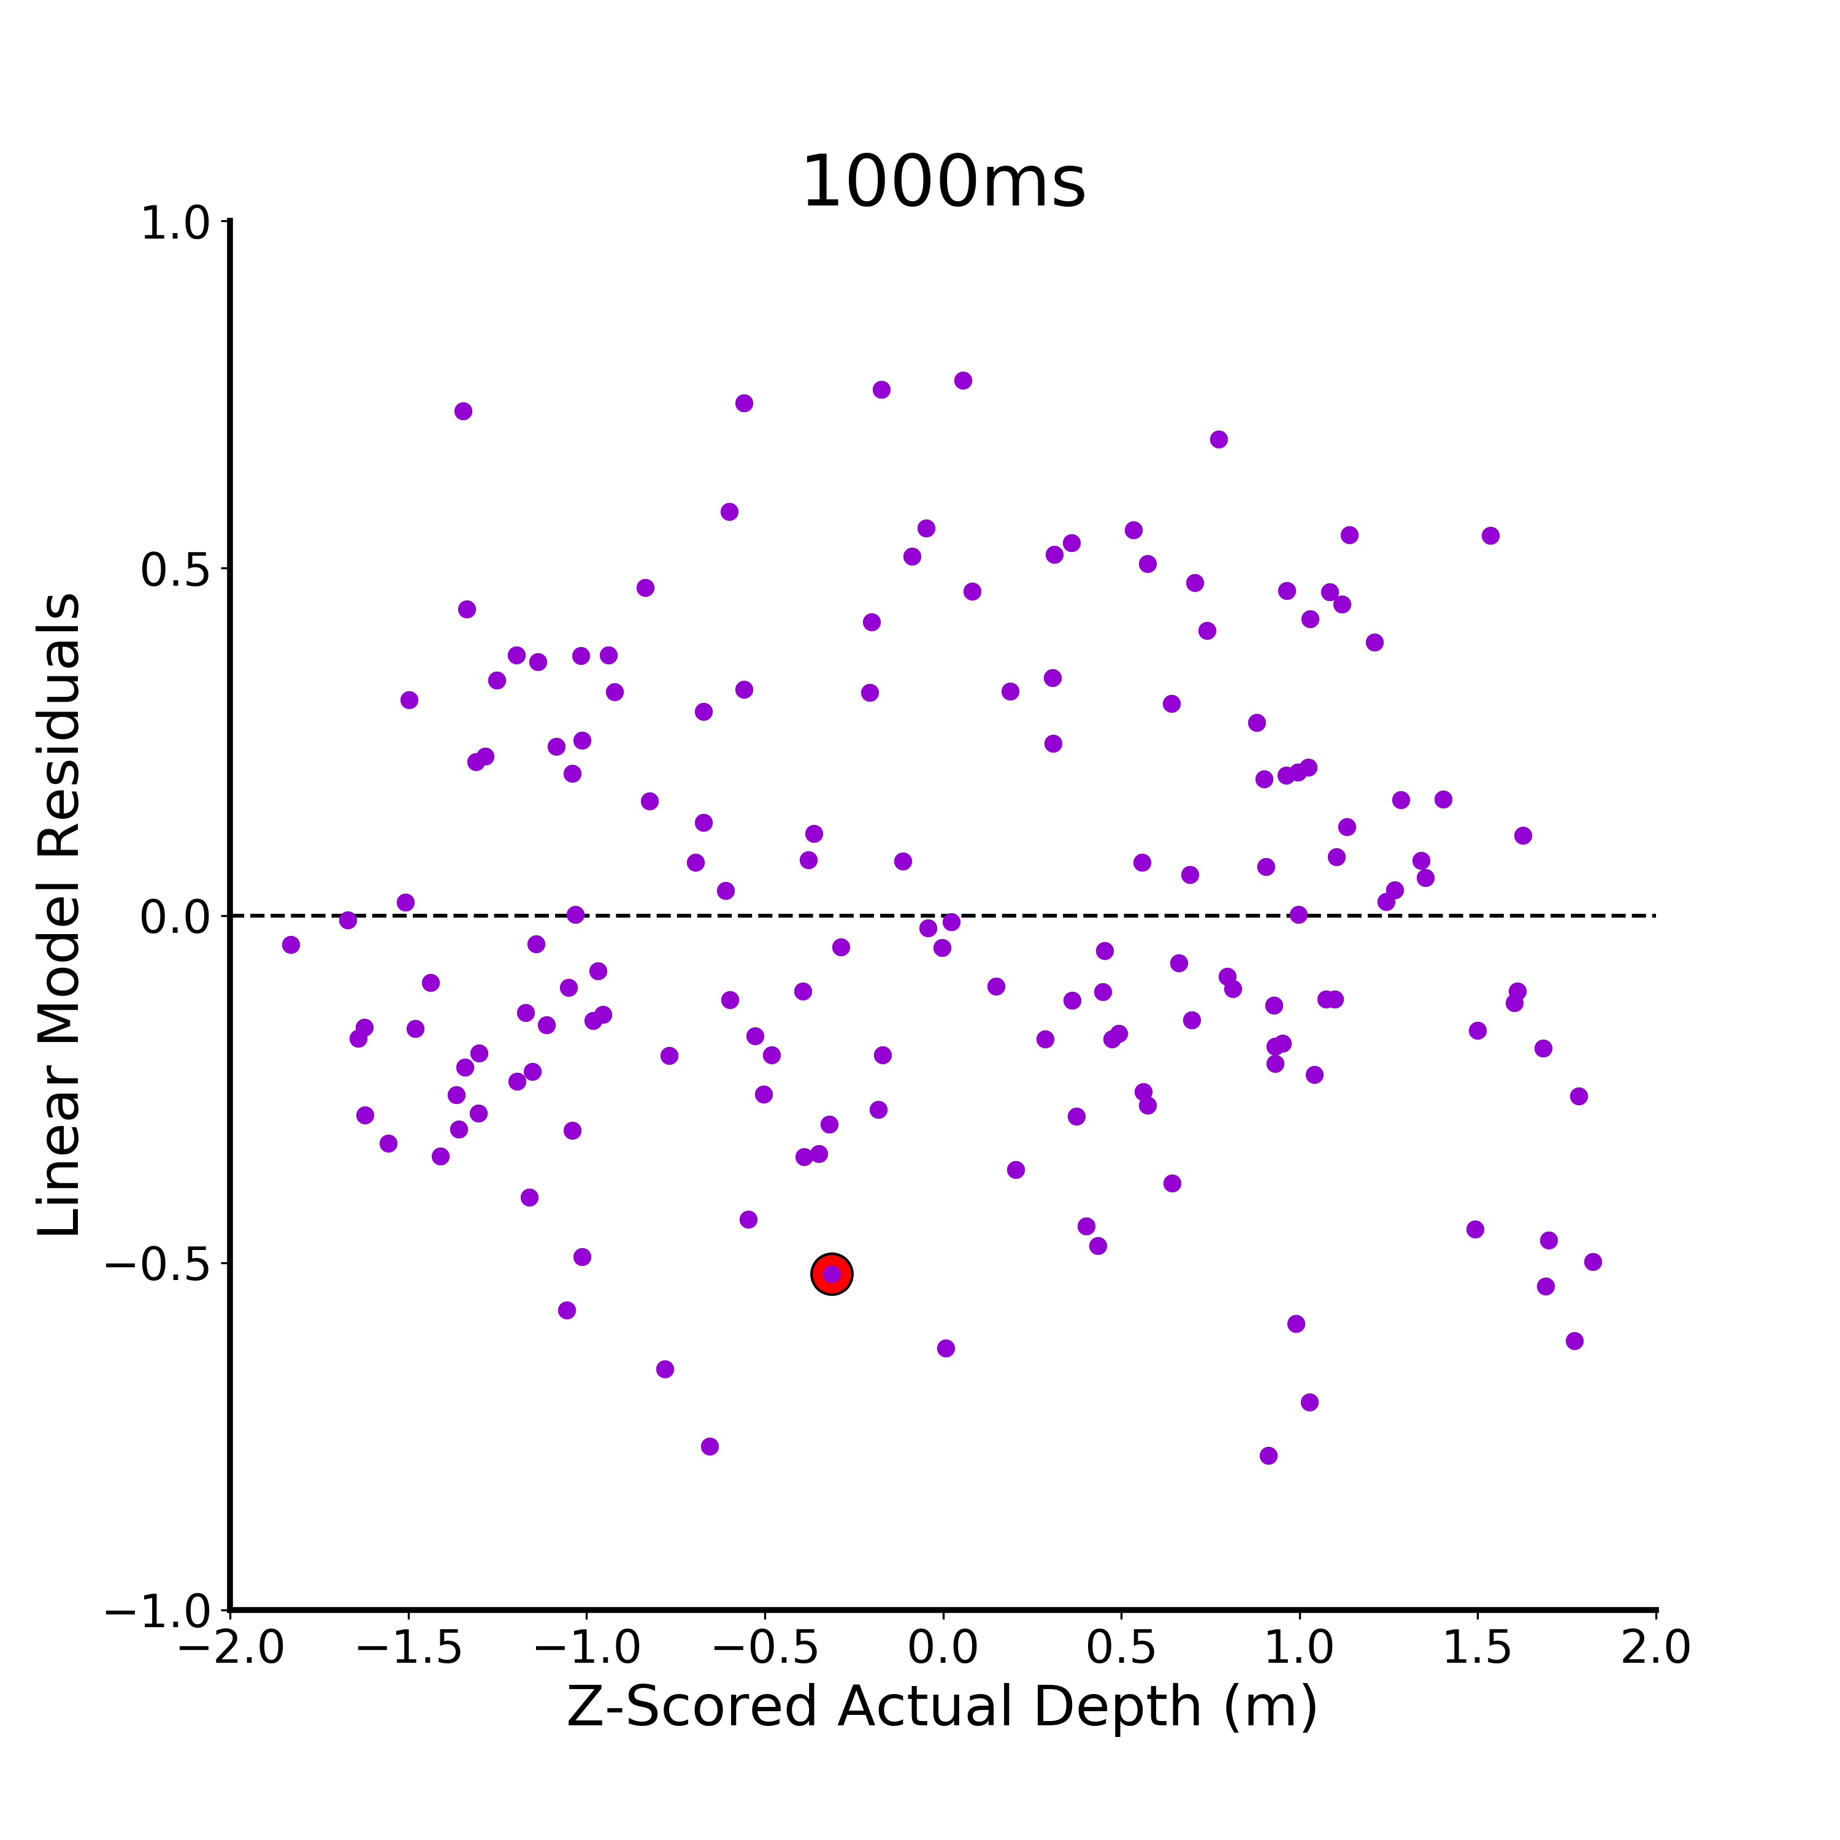
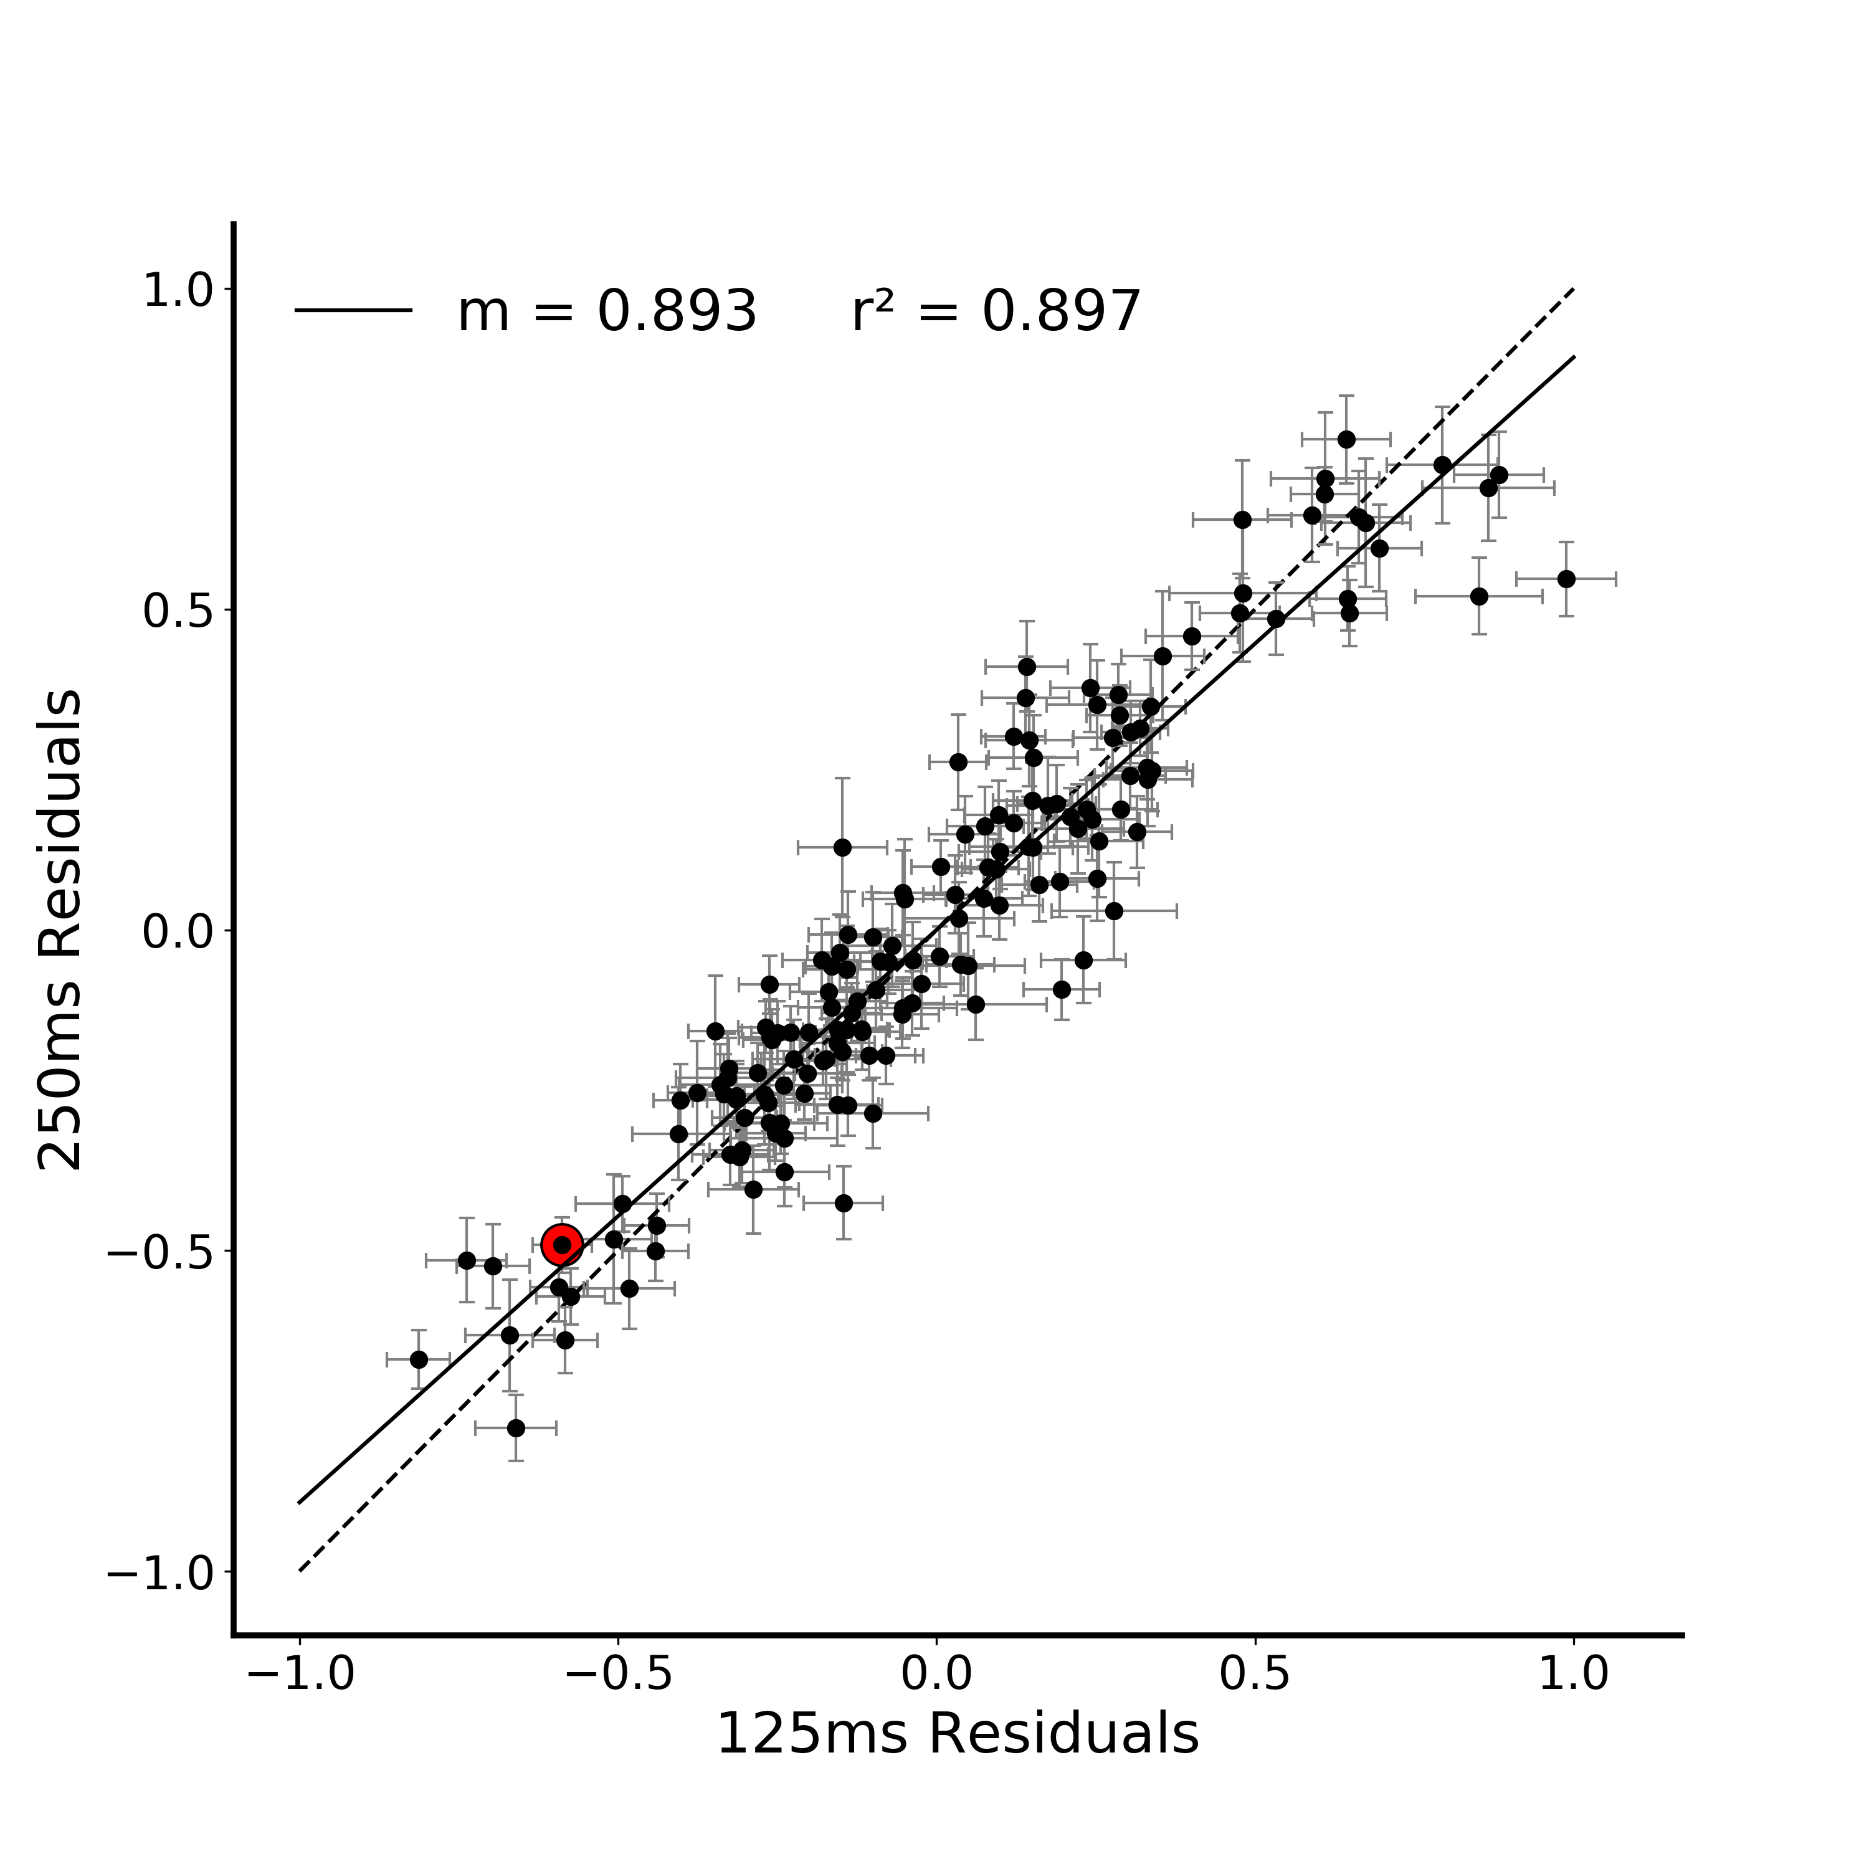
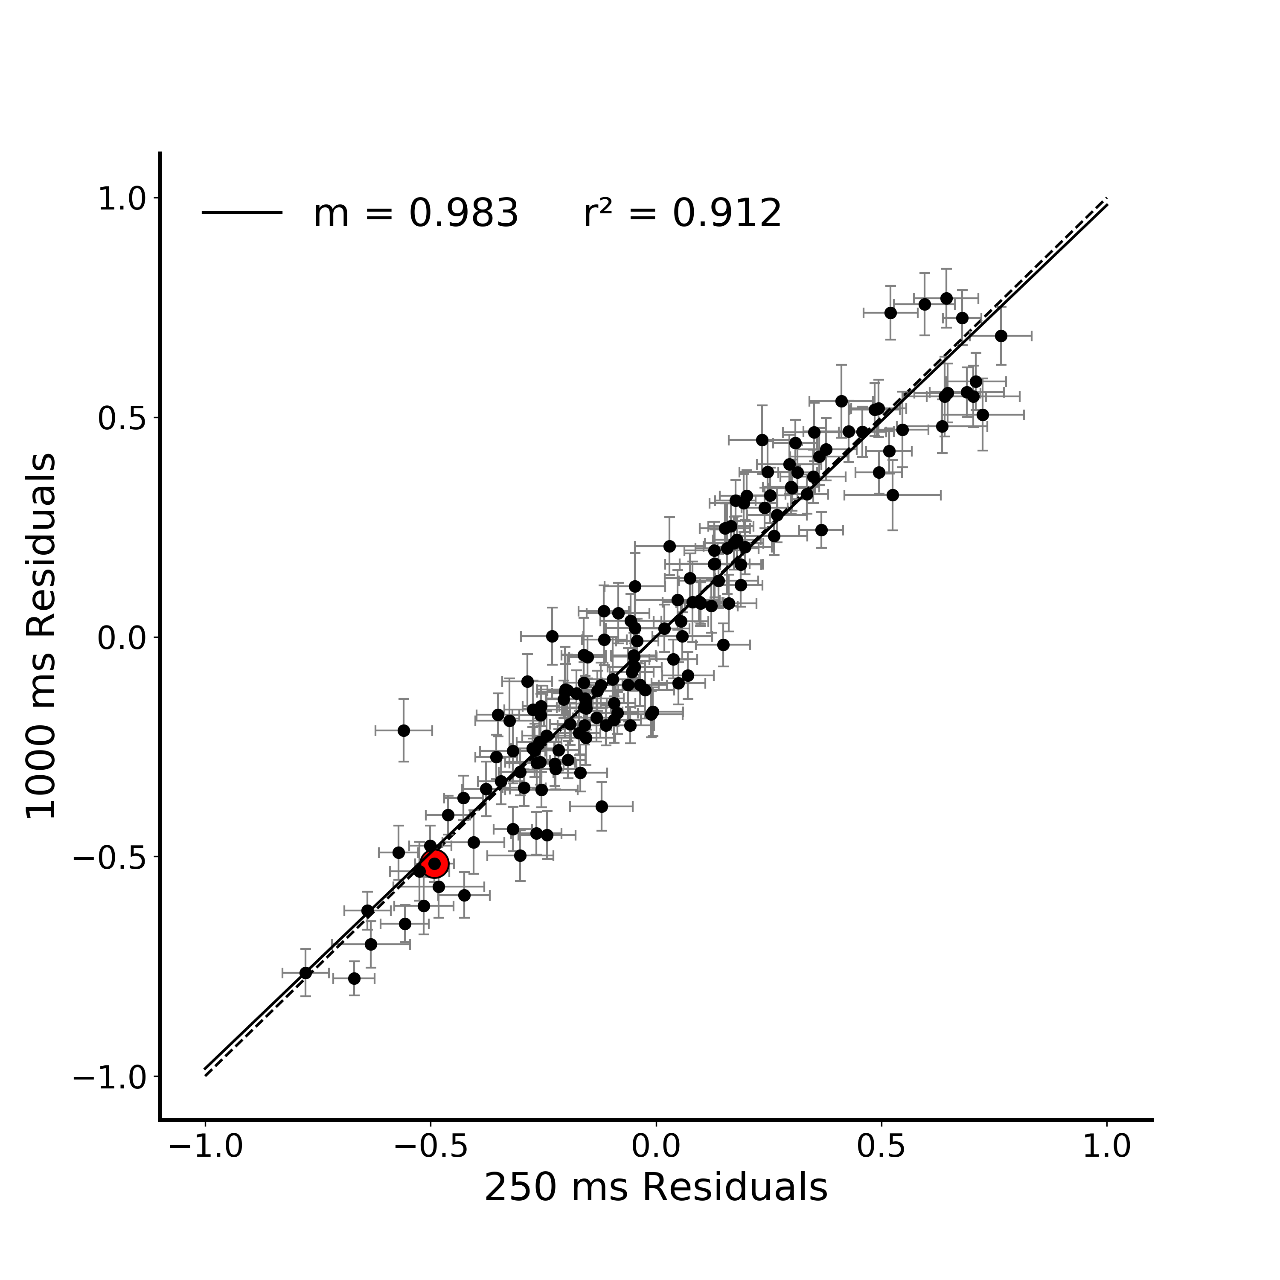
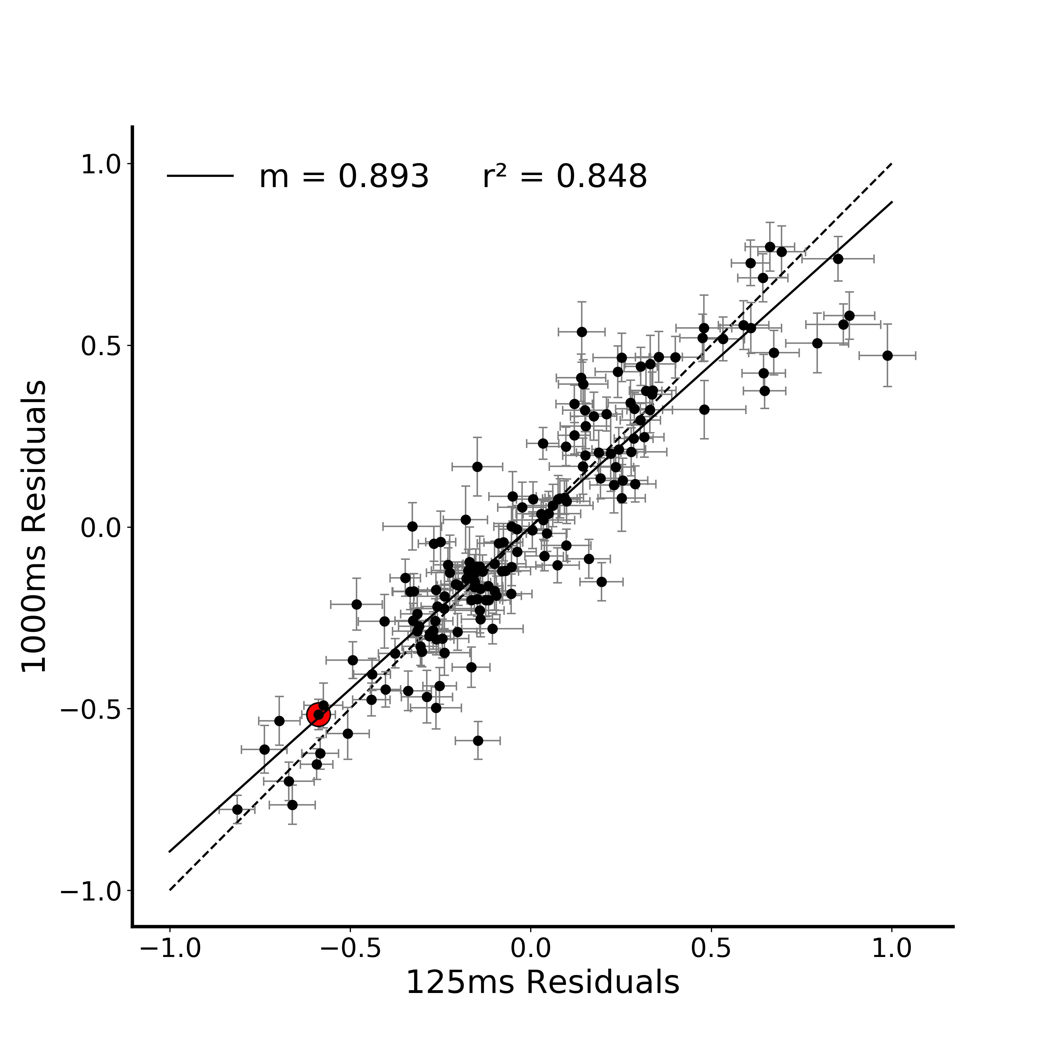
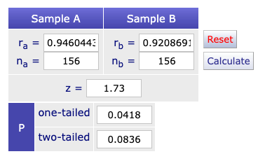
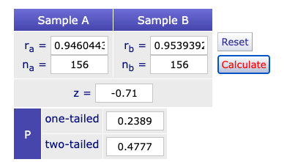
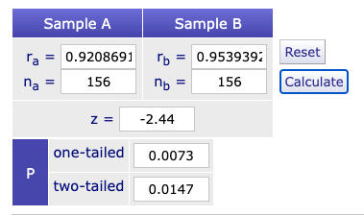
A.
*
B.
**
Figure 3. Correlation between verbal estimate regression residuals in Figure 2. A) Verbal estimate residuals (difference between the model prediction and the average estimate for that stimulus) at each viewing duration plotted against z-scored actual depth. The residual for a particular stimulus at each viewing duration is highlighted in red. B) Correlation between all combination of verbal estimate regression residuals at the three viewing durations (125, 250, 1000ms). The residual correlation for a particular stimulus is highlighted in red on all plots. (* indicates p < 0.05, ** indicates p < 0.01)
(125x250) (125x1000)
(125x250) x (250x1000)
(125x1000) x (250x1000)
Notes:
DONE
Note temporal evolution here (250 and 1000 are basically identical)
Pairwise compareisons between the plots – Fischers r to z transform (linearlizes the r values)
http://vassarstats.net/rdiff.html

Slide 4


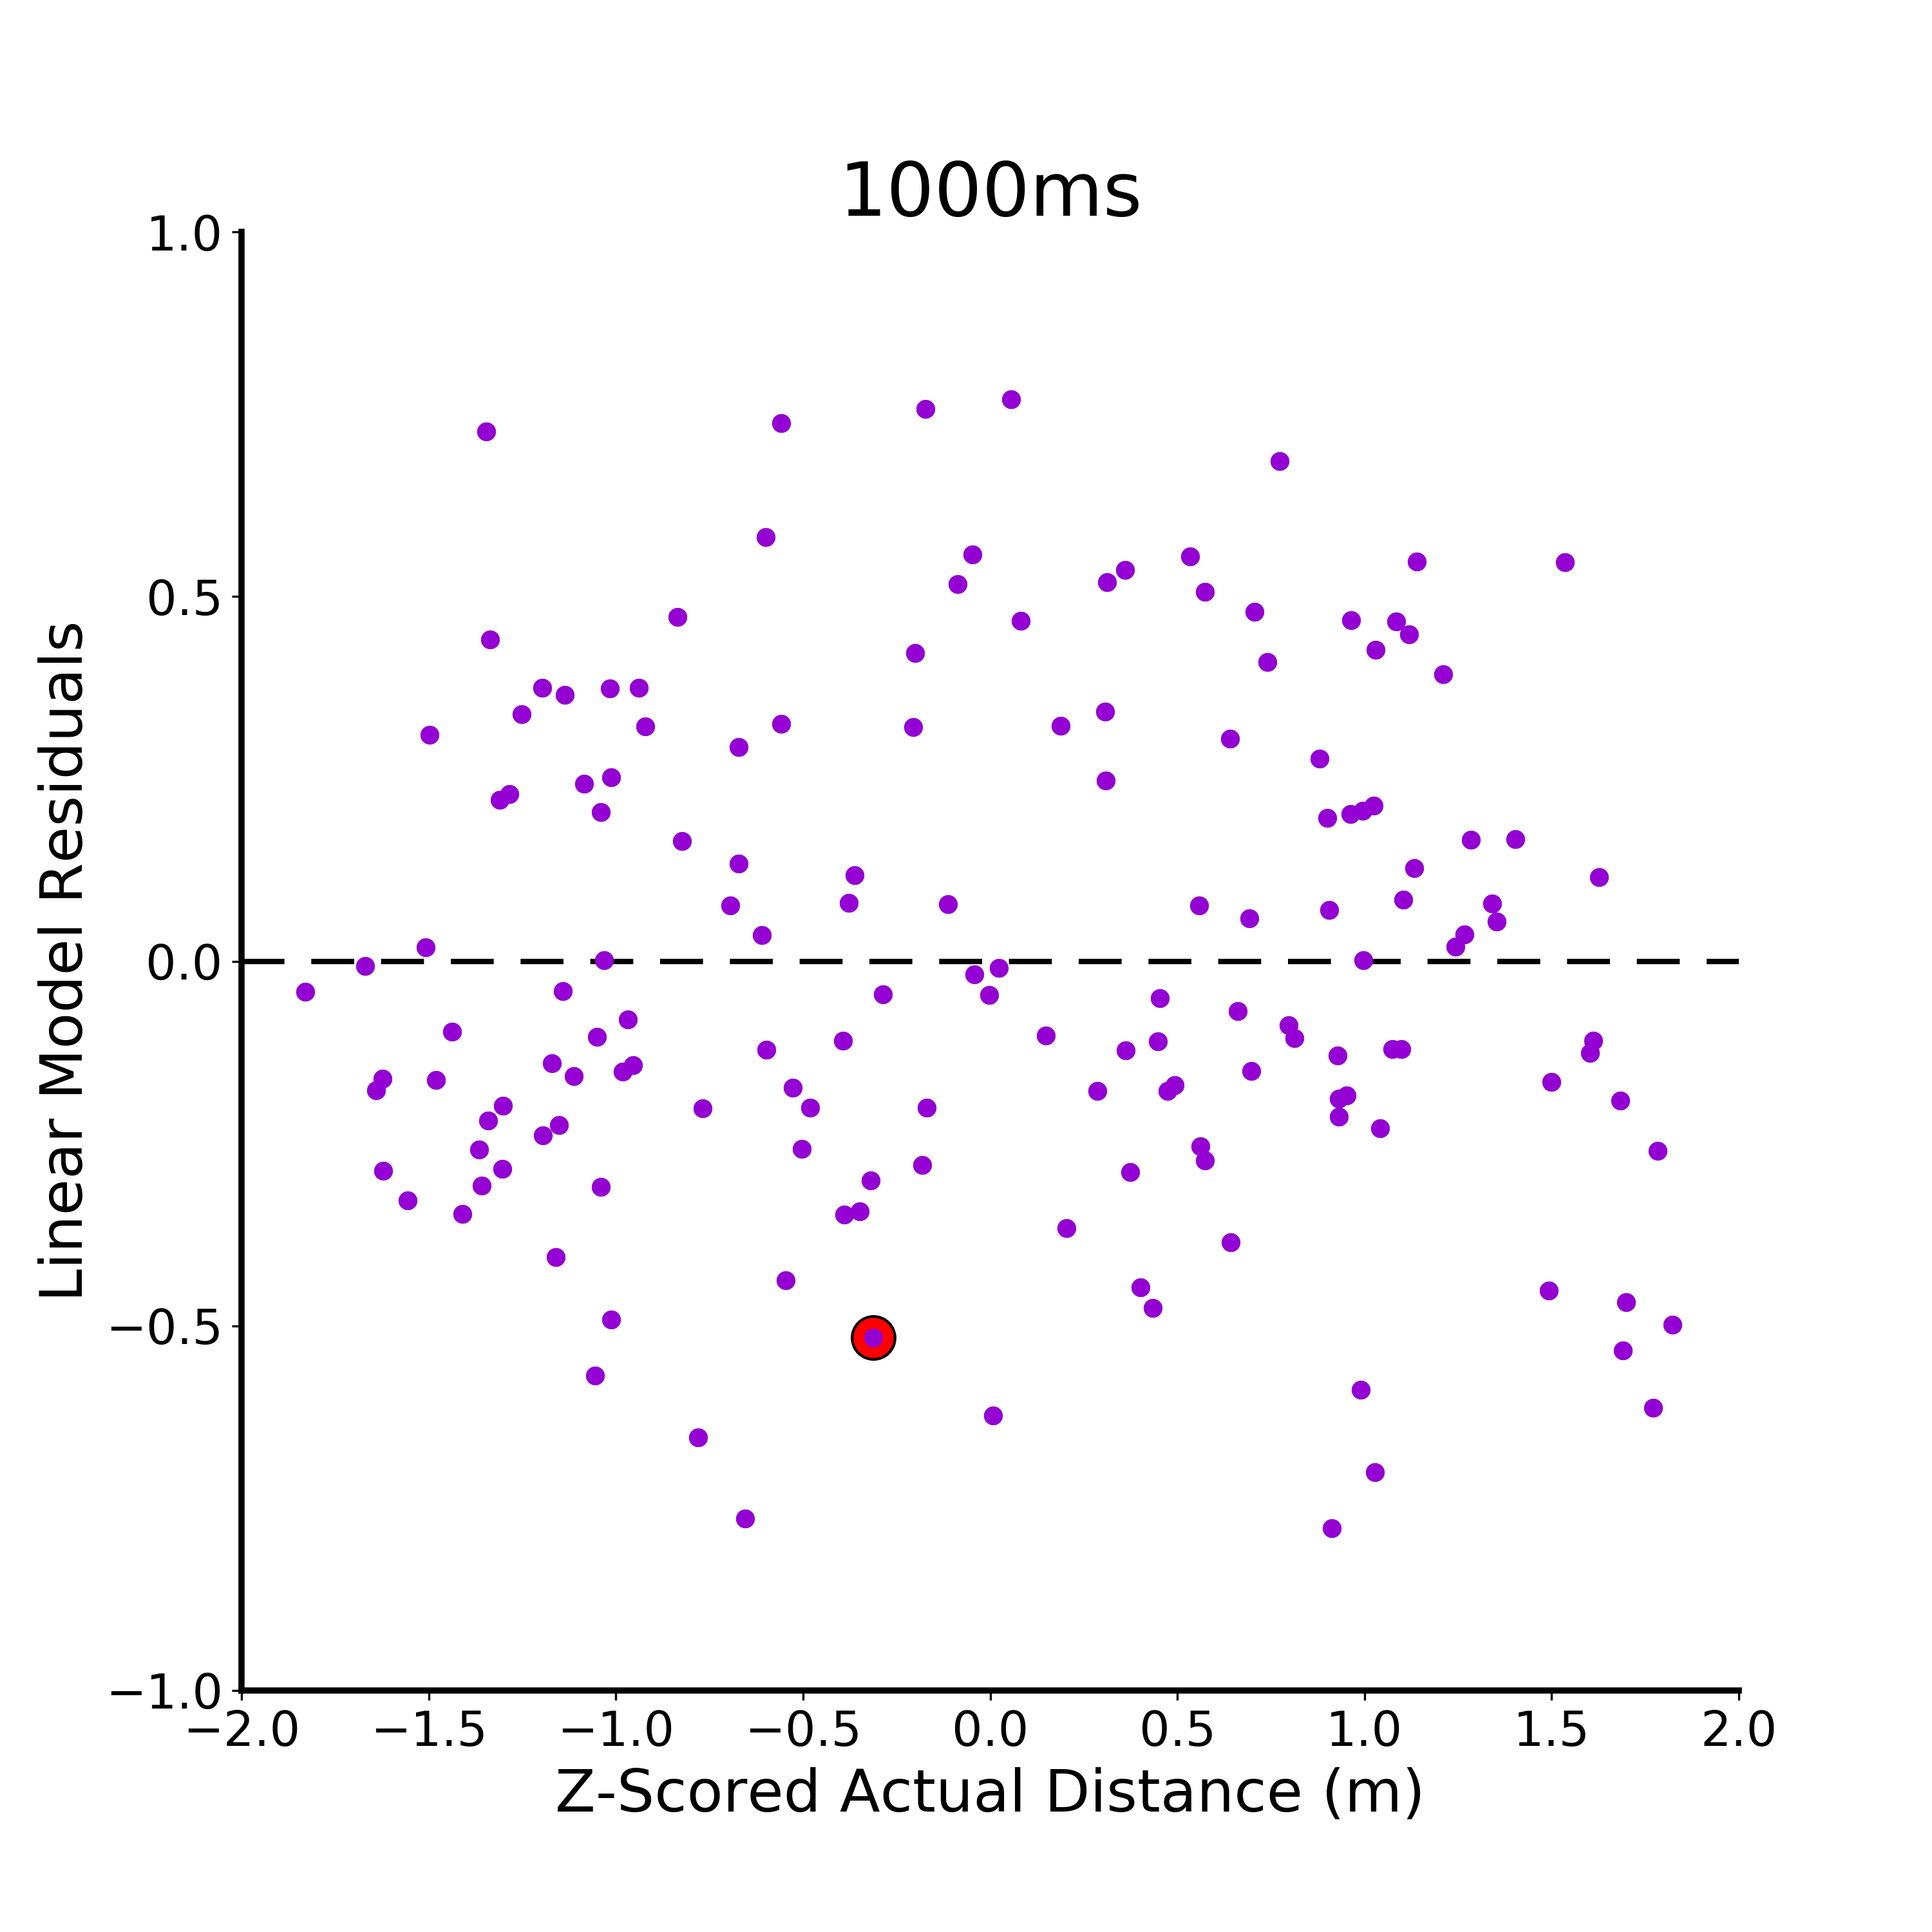
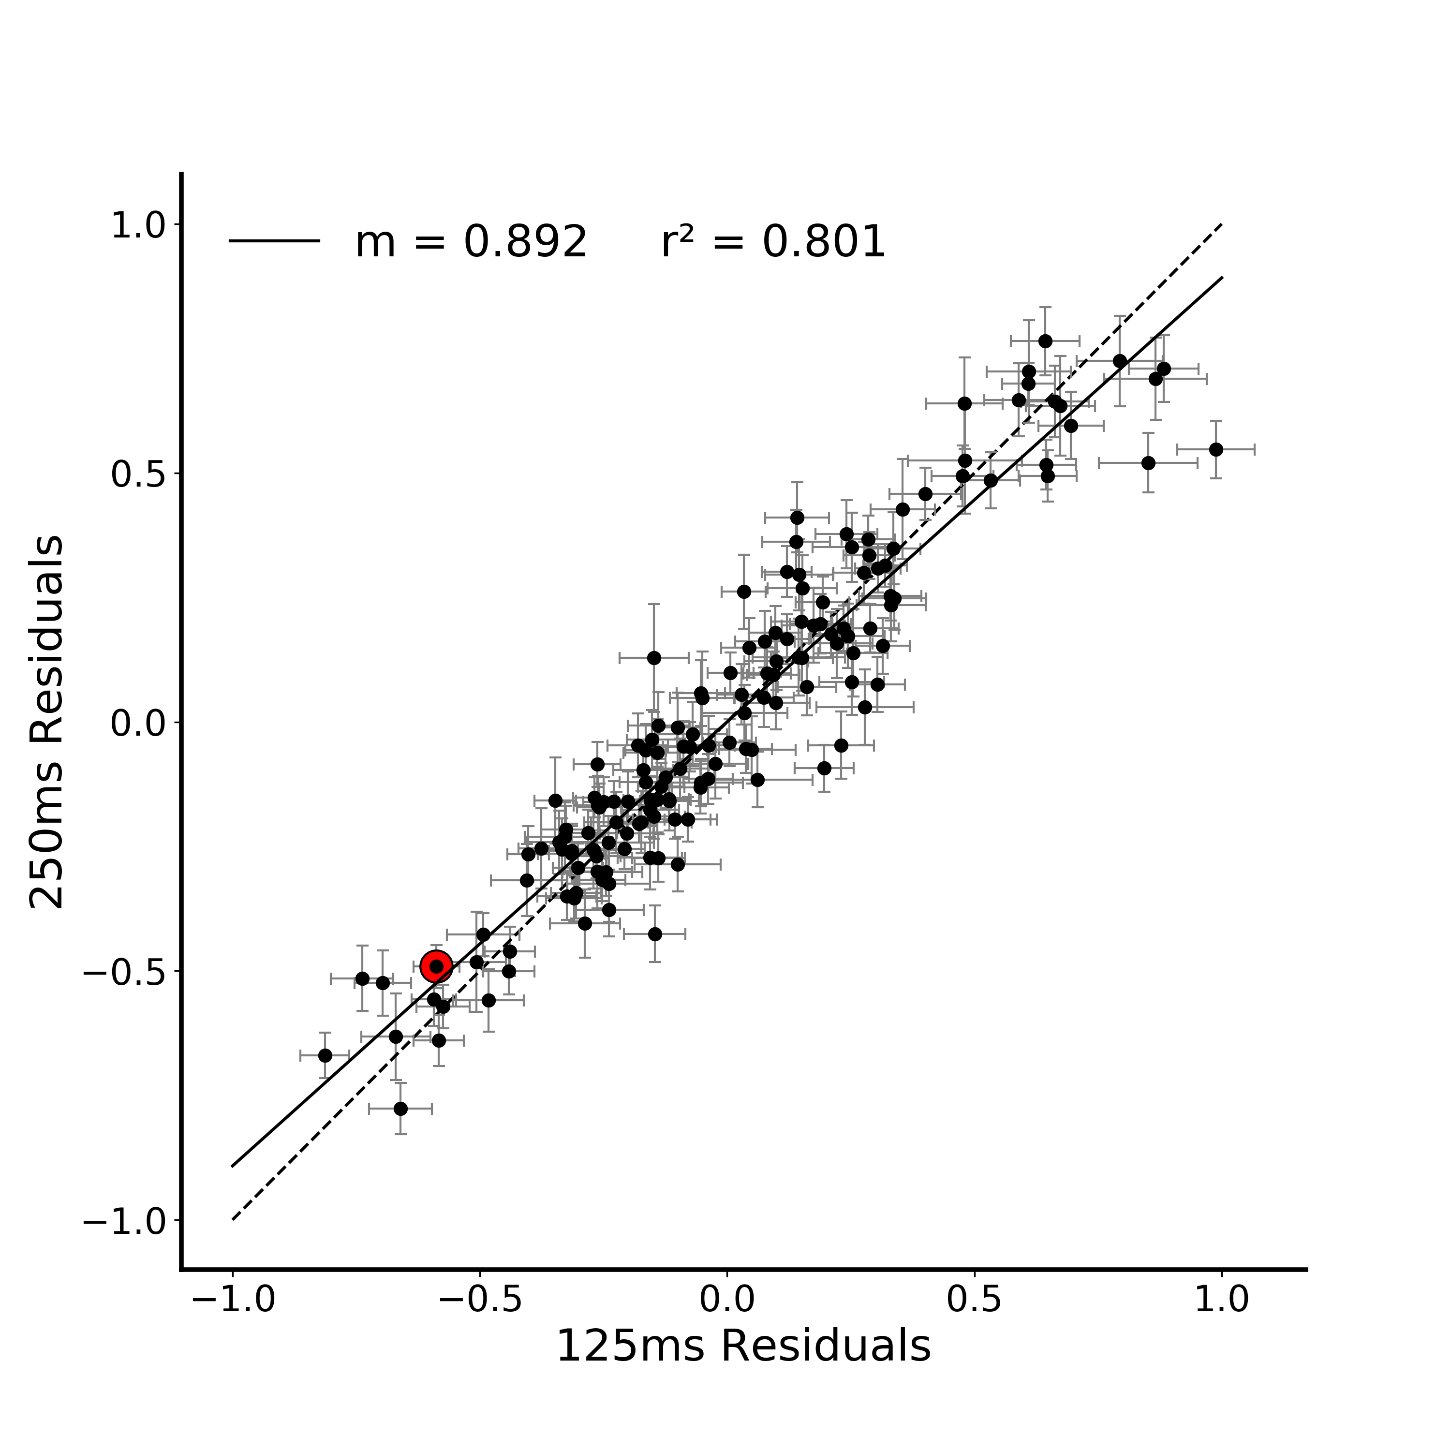


A.
*
**
B.
Figure 3. Correlation between metric estimate regression residuals in Figure 2. A) Metric estimate residuals (difference between the model prediction and the average estimate for that stimulus) at each viewing duration plotted against z-scored actual depth. The residual for a particular stimulus at each viewing duration is highlighted in red. B) Correlation between all combination of metric estimate regression residuals at the three viewing durations (125, 250, 1000ms). The residual correlation for a particular stimulus is highlighted in red on all plots. (* indicates p < 0.05, ** indicates p < 0.01)
Notes:
DONE
Note temporal evolution here (250 and 1000 are basically identical)
Pairwise compareisons between the plots – Fischers r to z transform (linearlizes the r values)
http://vassarstats.net/rdiff.html

Slide 5
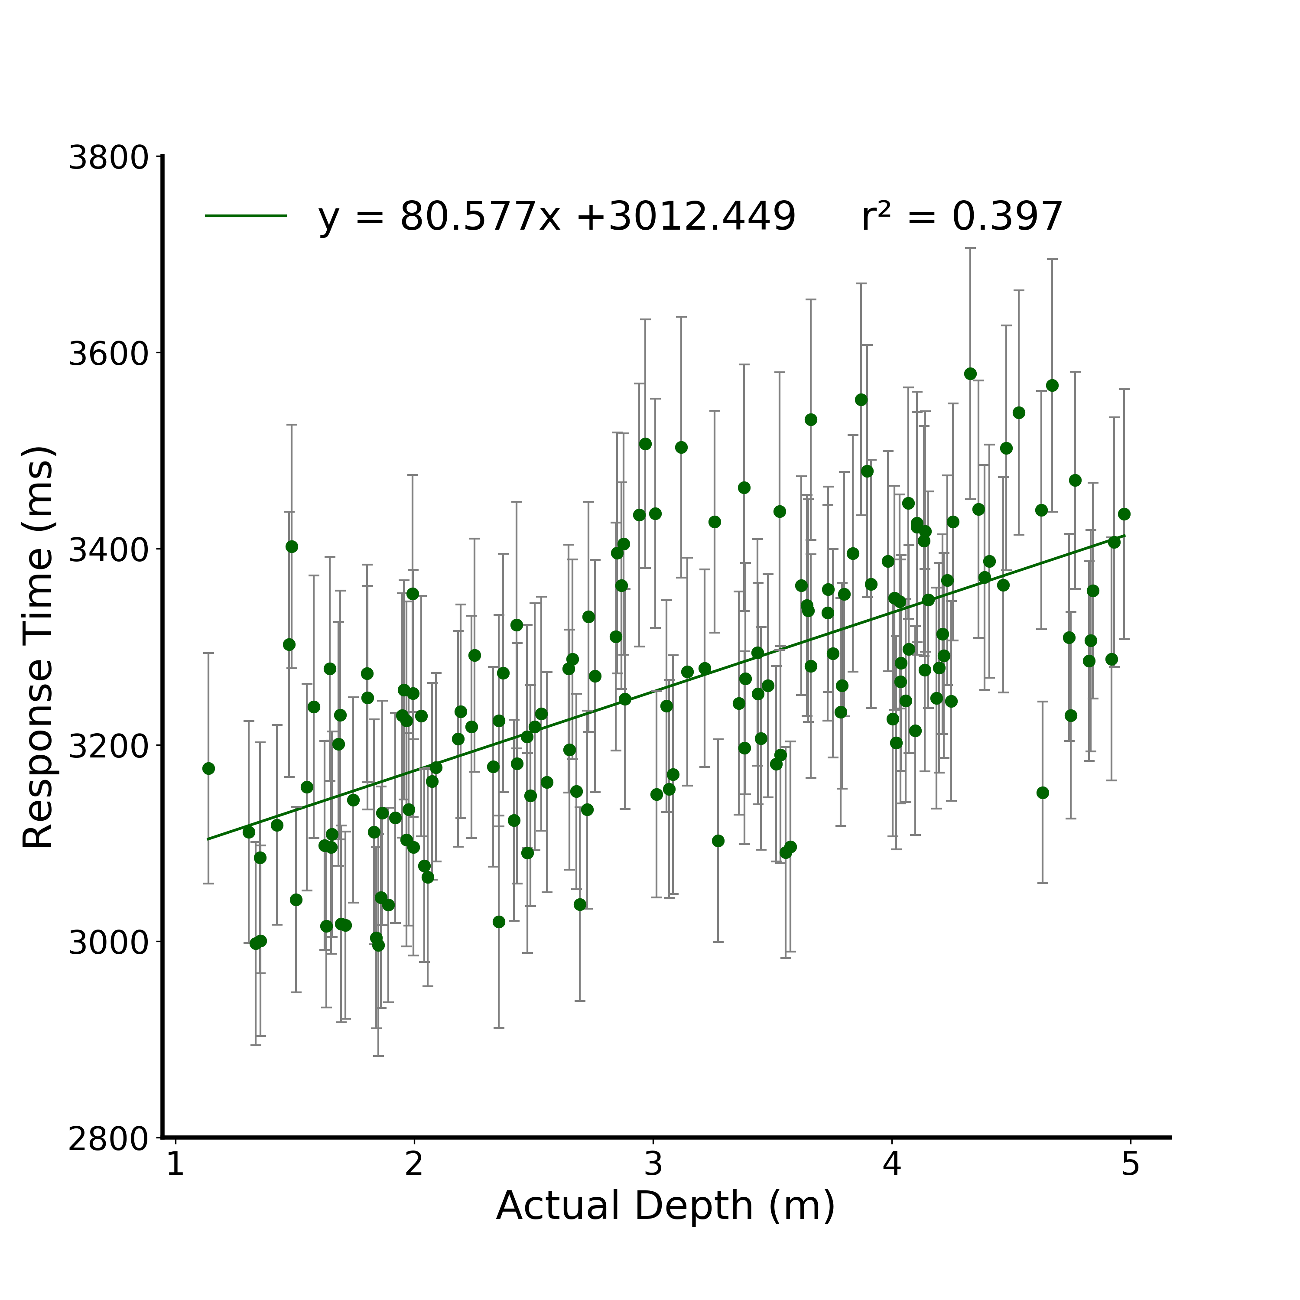

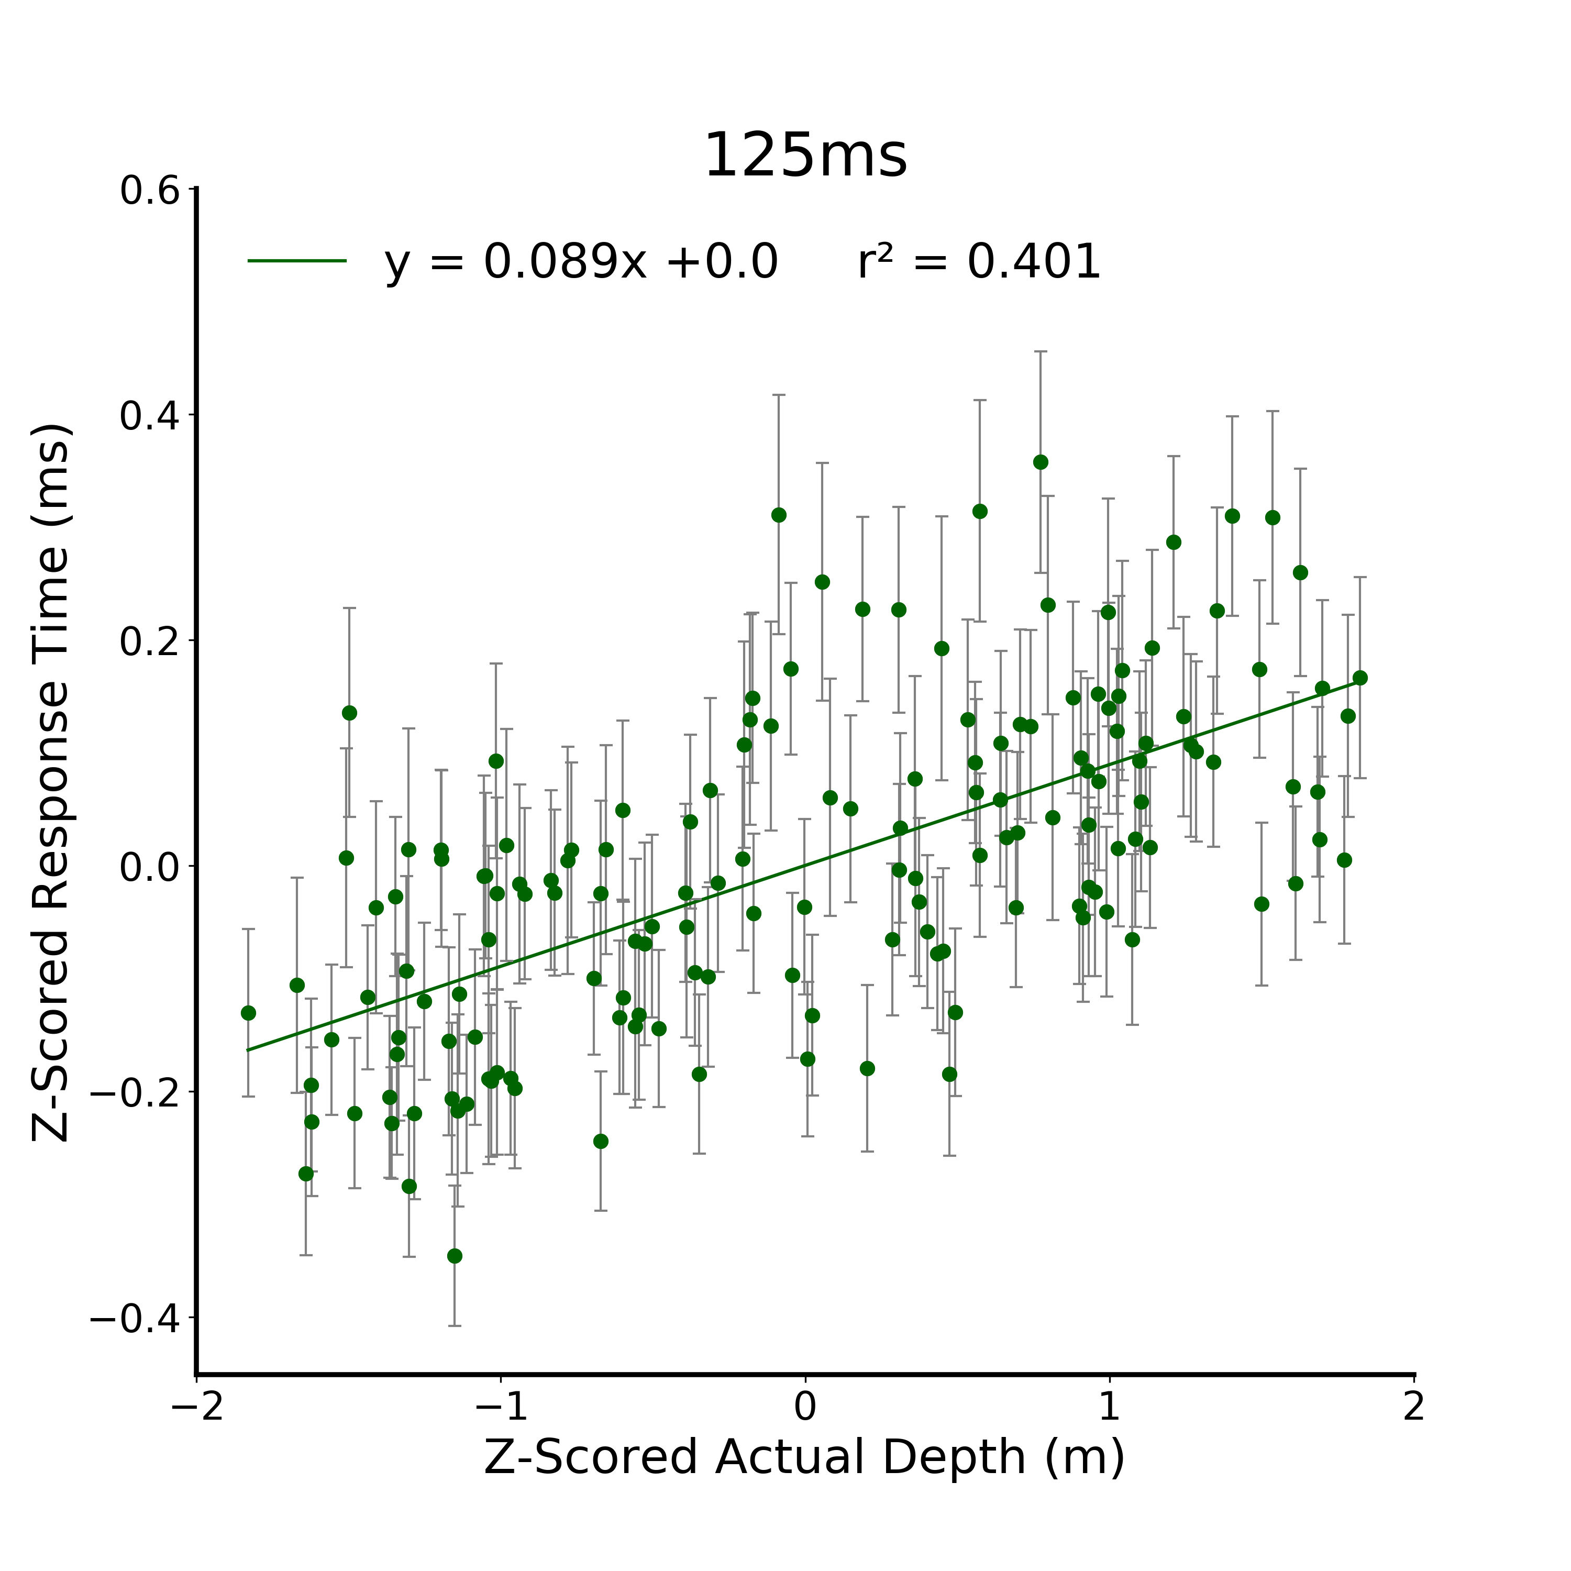
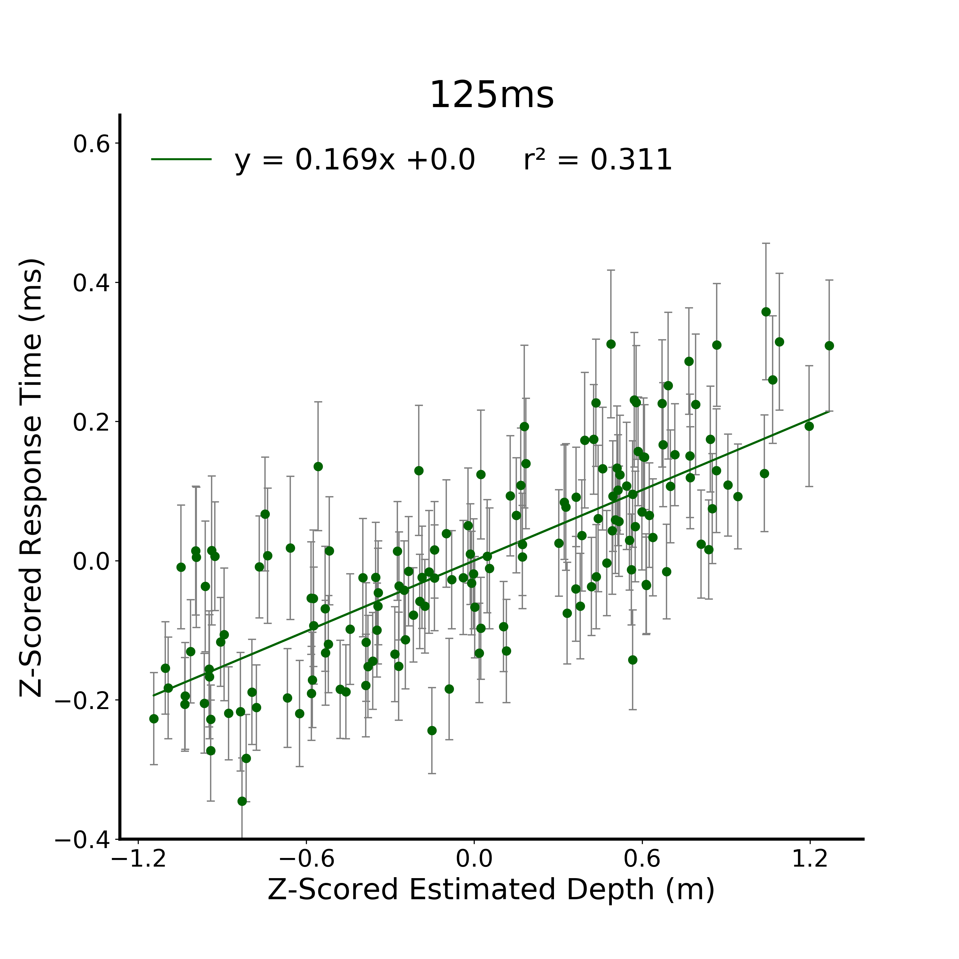

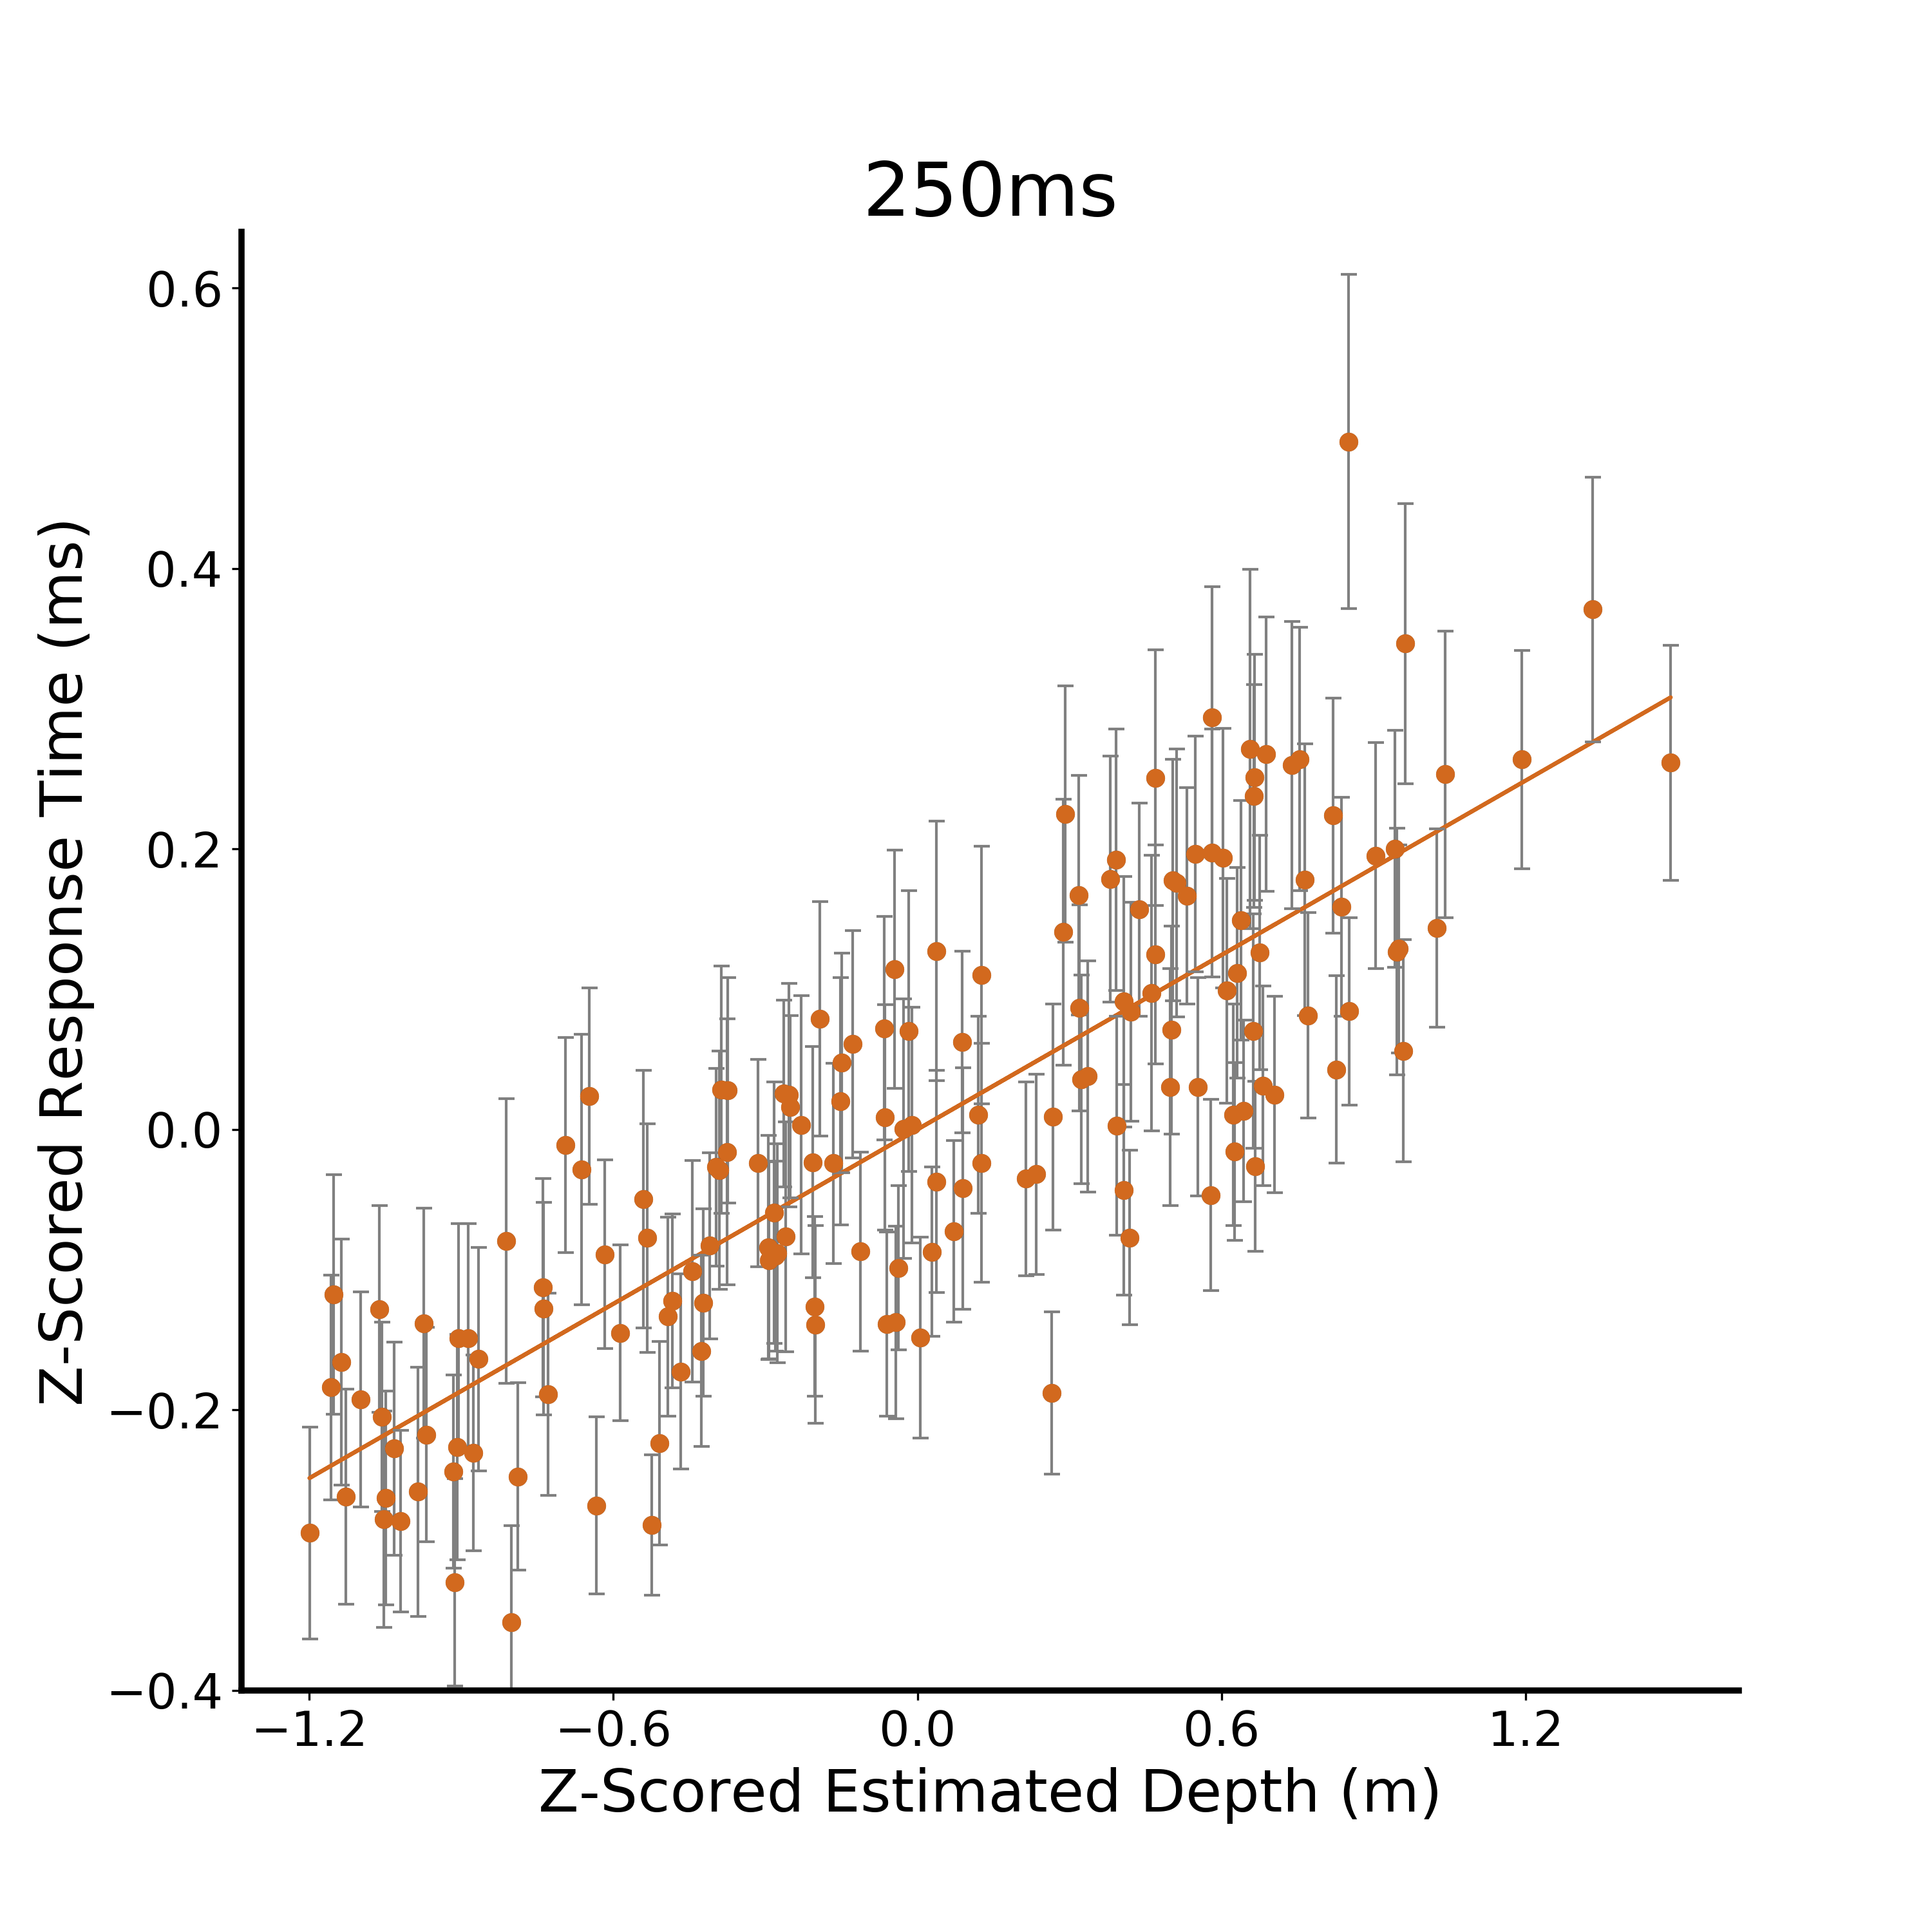
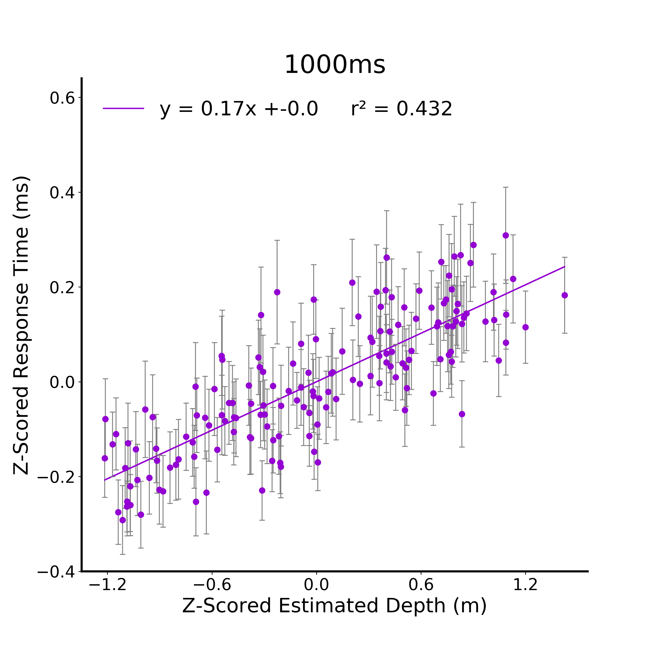
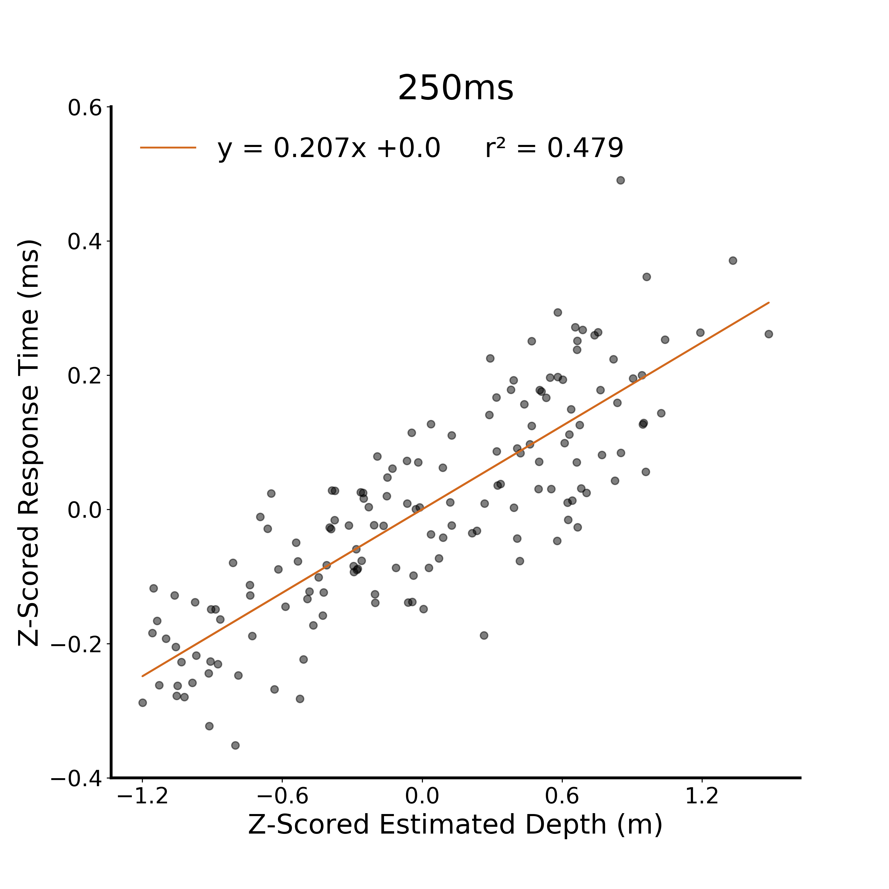
A.
Figure 4. Metric Estimate Response Time Linear Models. A) Raw response time from the metric estimate task for the 125 ms viewing duration condition regressed against actual depth. Participants are independent between viewing duration conditions and all error bars in plots are between subjects standard error. B) Z-scored response time at 125ms against z-scored actual depth. C) Z-scored response time at 125ms against z-scored estimated depth. D) Z-scored response time at 125ms against z-scored estimated depth. E) Z-scored response time at 125ms against z-scored estimated depth. Model intercepts in B-E are all 0, therefore not reported in the figure.
B.
C.
D.
E.
Notes:
DONE

Slide 6

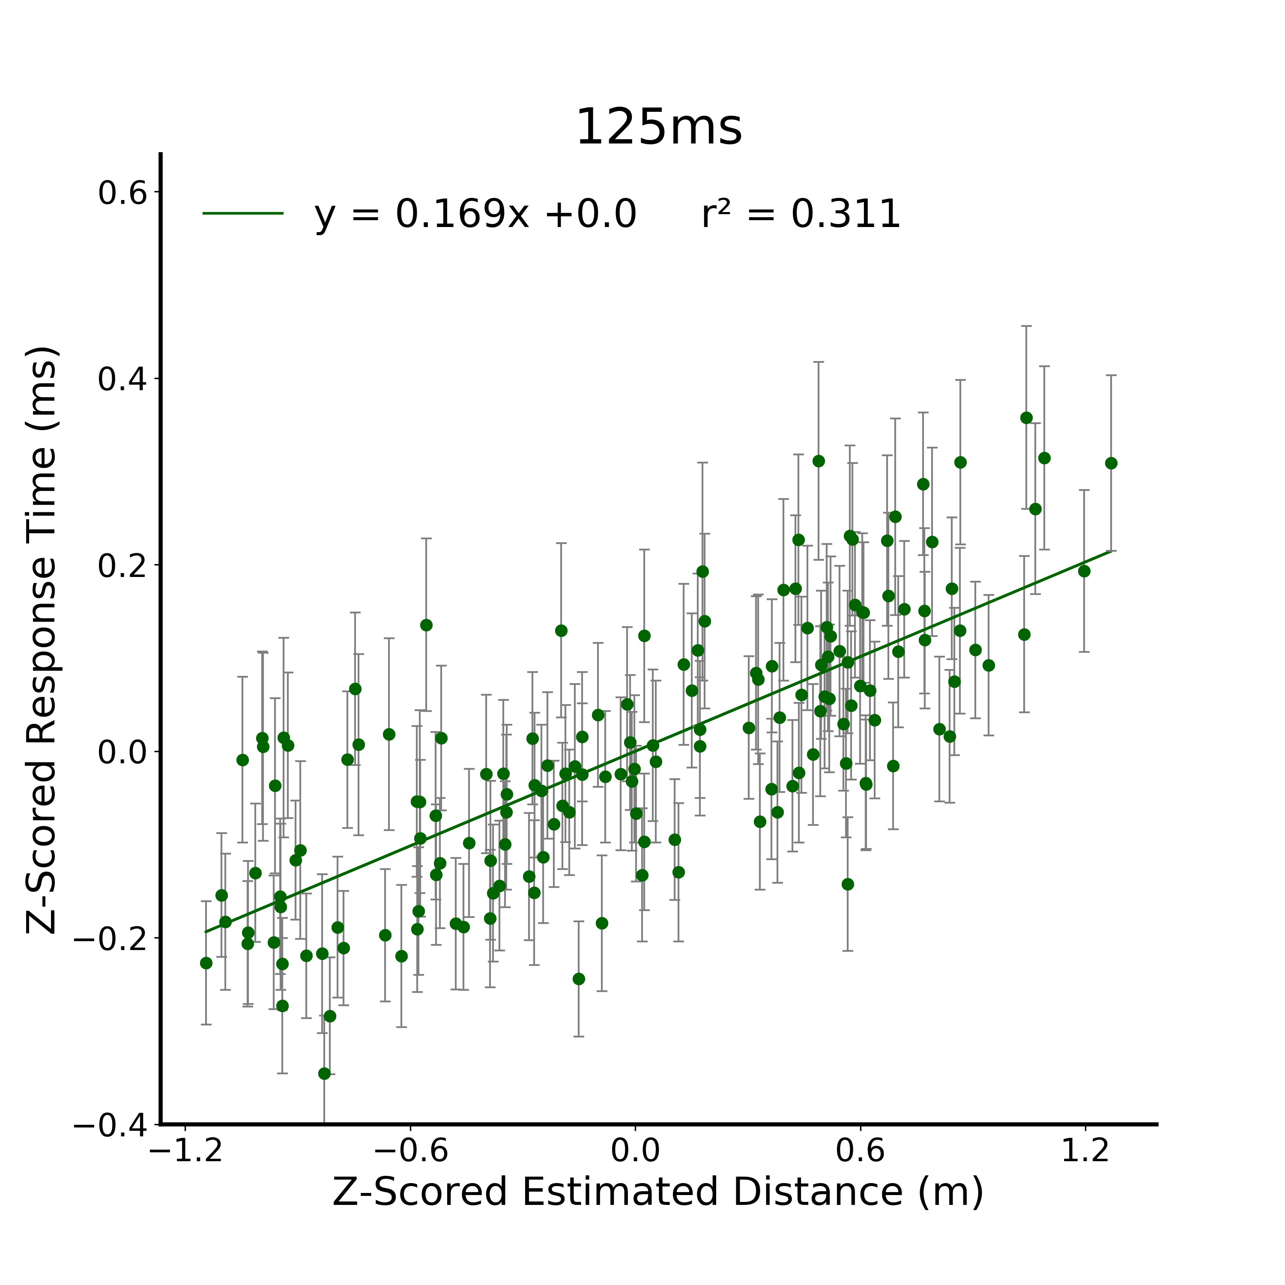
A.
B.
C.
D.
E.
Notes:
DONE

Slide 7
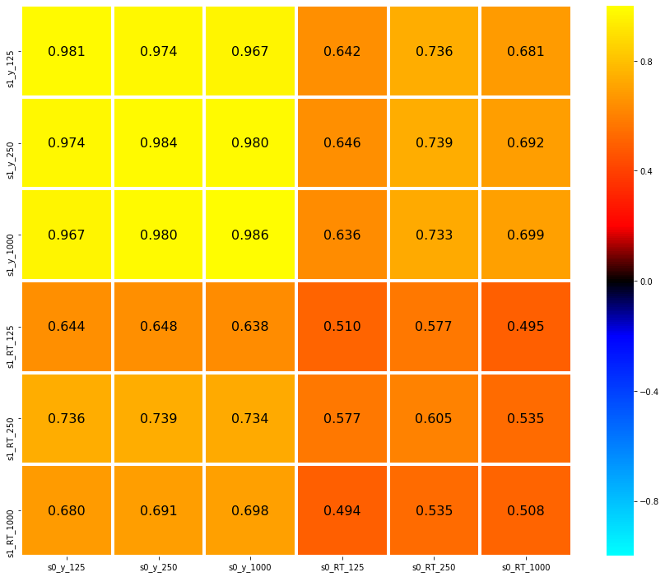

Slide 8
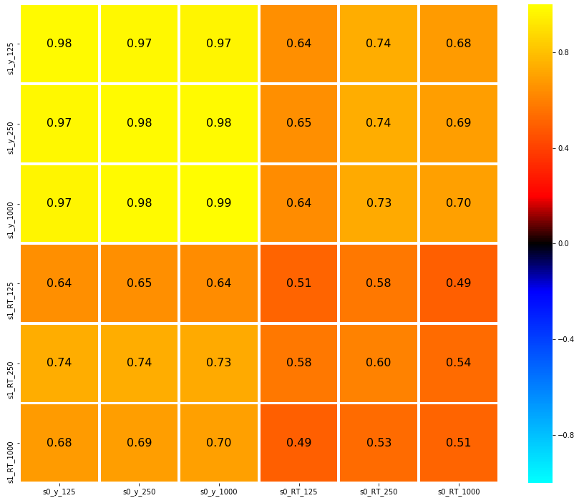
125
0.8
Depth Estimate
250
0.4
1000
*
0.16
0
Correlation
*
125
- 0.16
- 0.4
Response Time
250
1000
- 0.8
125
250
1000
125
250
1000
Depth Estimate
Response Time
Figure 5. Metric Estimate Average Correlation Matrix. Data were randomly split in half and correlated against itself. This was repeated 10,000 times resulting in this average correlation matrix. Given a sample size of 156 images and a significance level of 0.05, r >= 0.16 are significant. Within task outcome correlations are significant within and between viewing durations, demonstrating strong reliability between independent groups of participants. Significant correlations between task outcome (response time, depth estimate) and viewing durations were also observed, indicating stimulus-level generalization.

Slide 9
125
0.8
Distance Estimate
250
0.4
1000
0.16
*
Correlation
0
125
- 0.16
*
Response Time
- 0.4
250
1000
- 0.8
125
250
1000
125
250
1000
Distance Estimate
Response Time
Figure 5. Metric Estimate Average Correlation Matrix. Data were randomly split in half and correlated against itself. This was repeated 10,000 times resulting in this average correlation matrix. Given a sample size of 156 images and a significance level of 0.05, r >= 0.16 are significant. Within task outcome correlations are significant within and between viewing durations, demonstrating strong reliability between independent groups of participants. Significant correlations between task outcome (response time, depth estimate) and viewing durations were also observed, indicating stimulus-level generalization.
Notes:
DONE

Slide 10
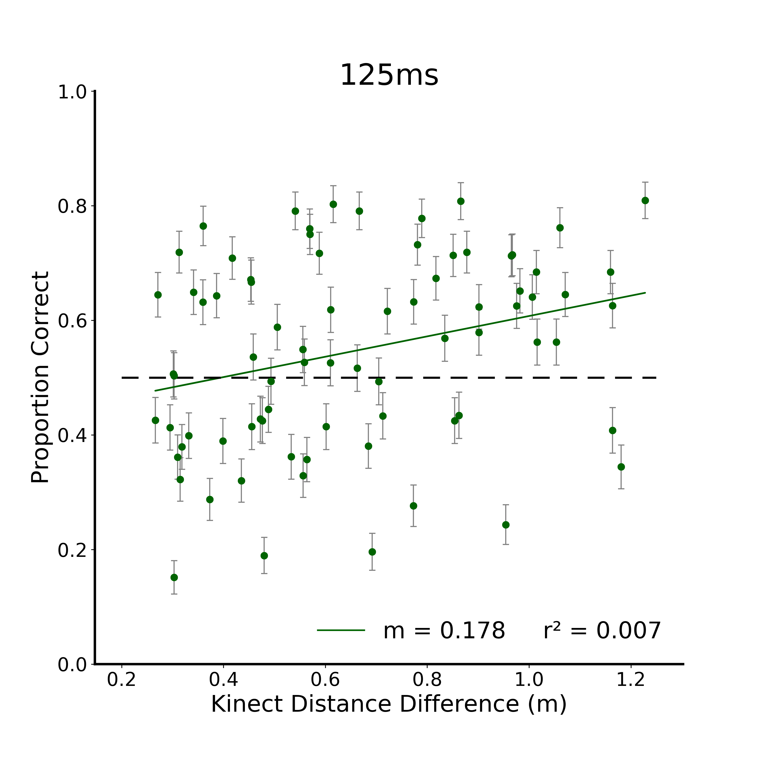
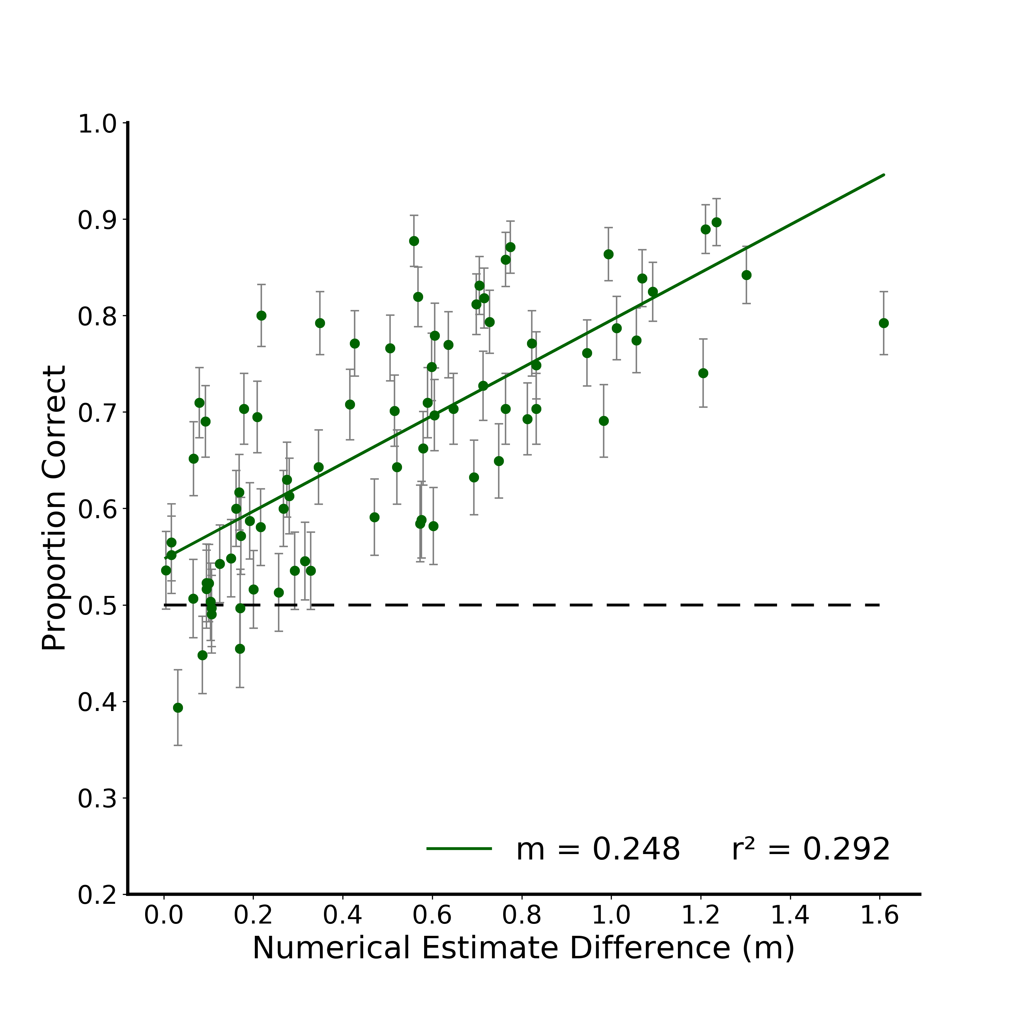

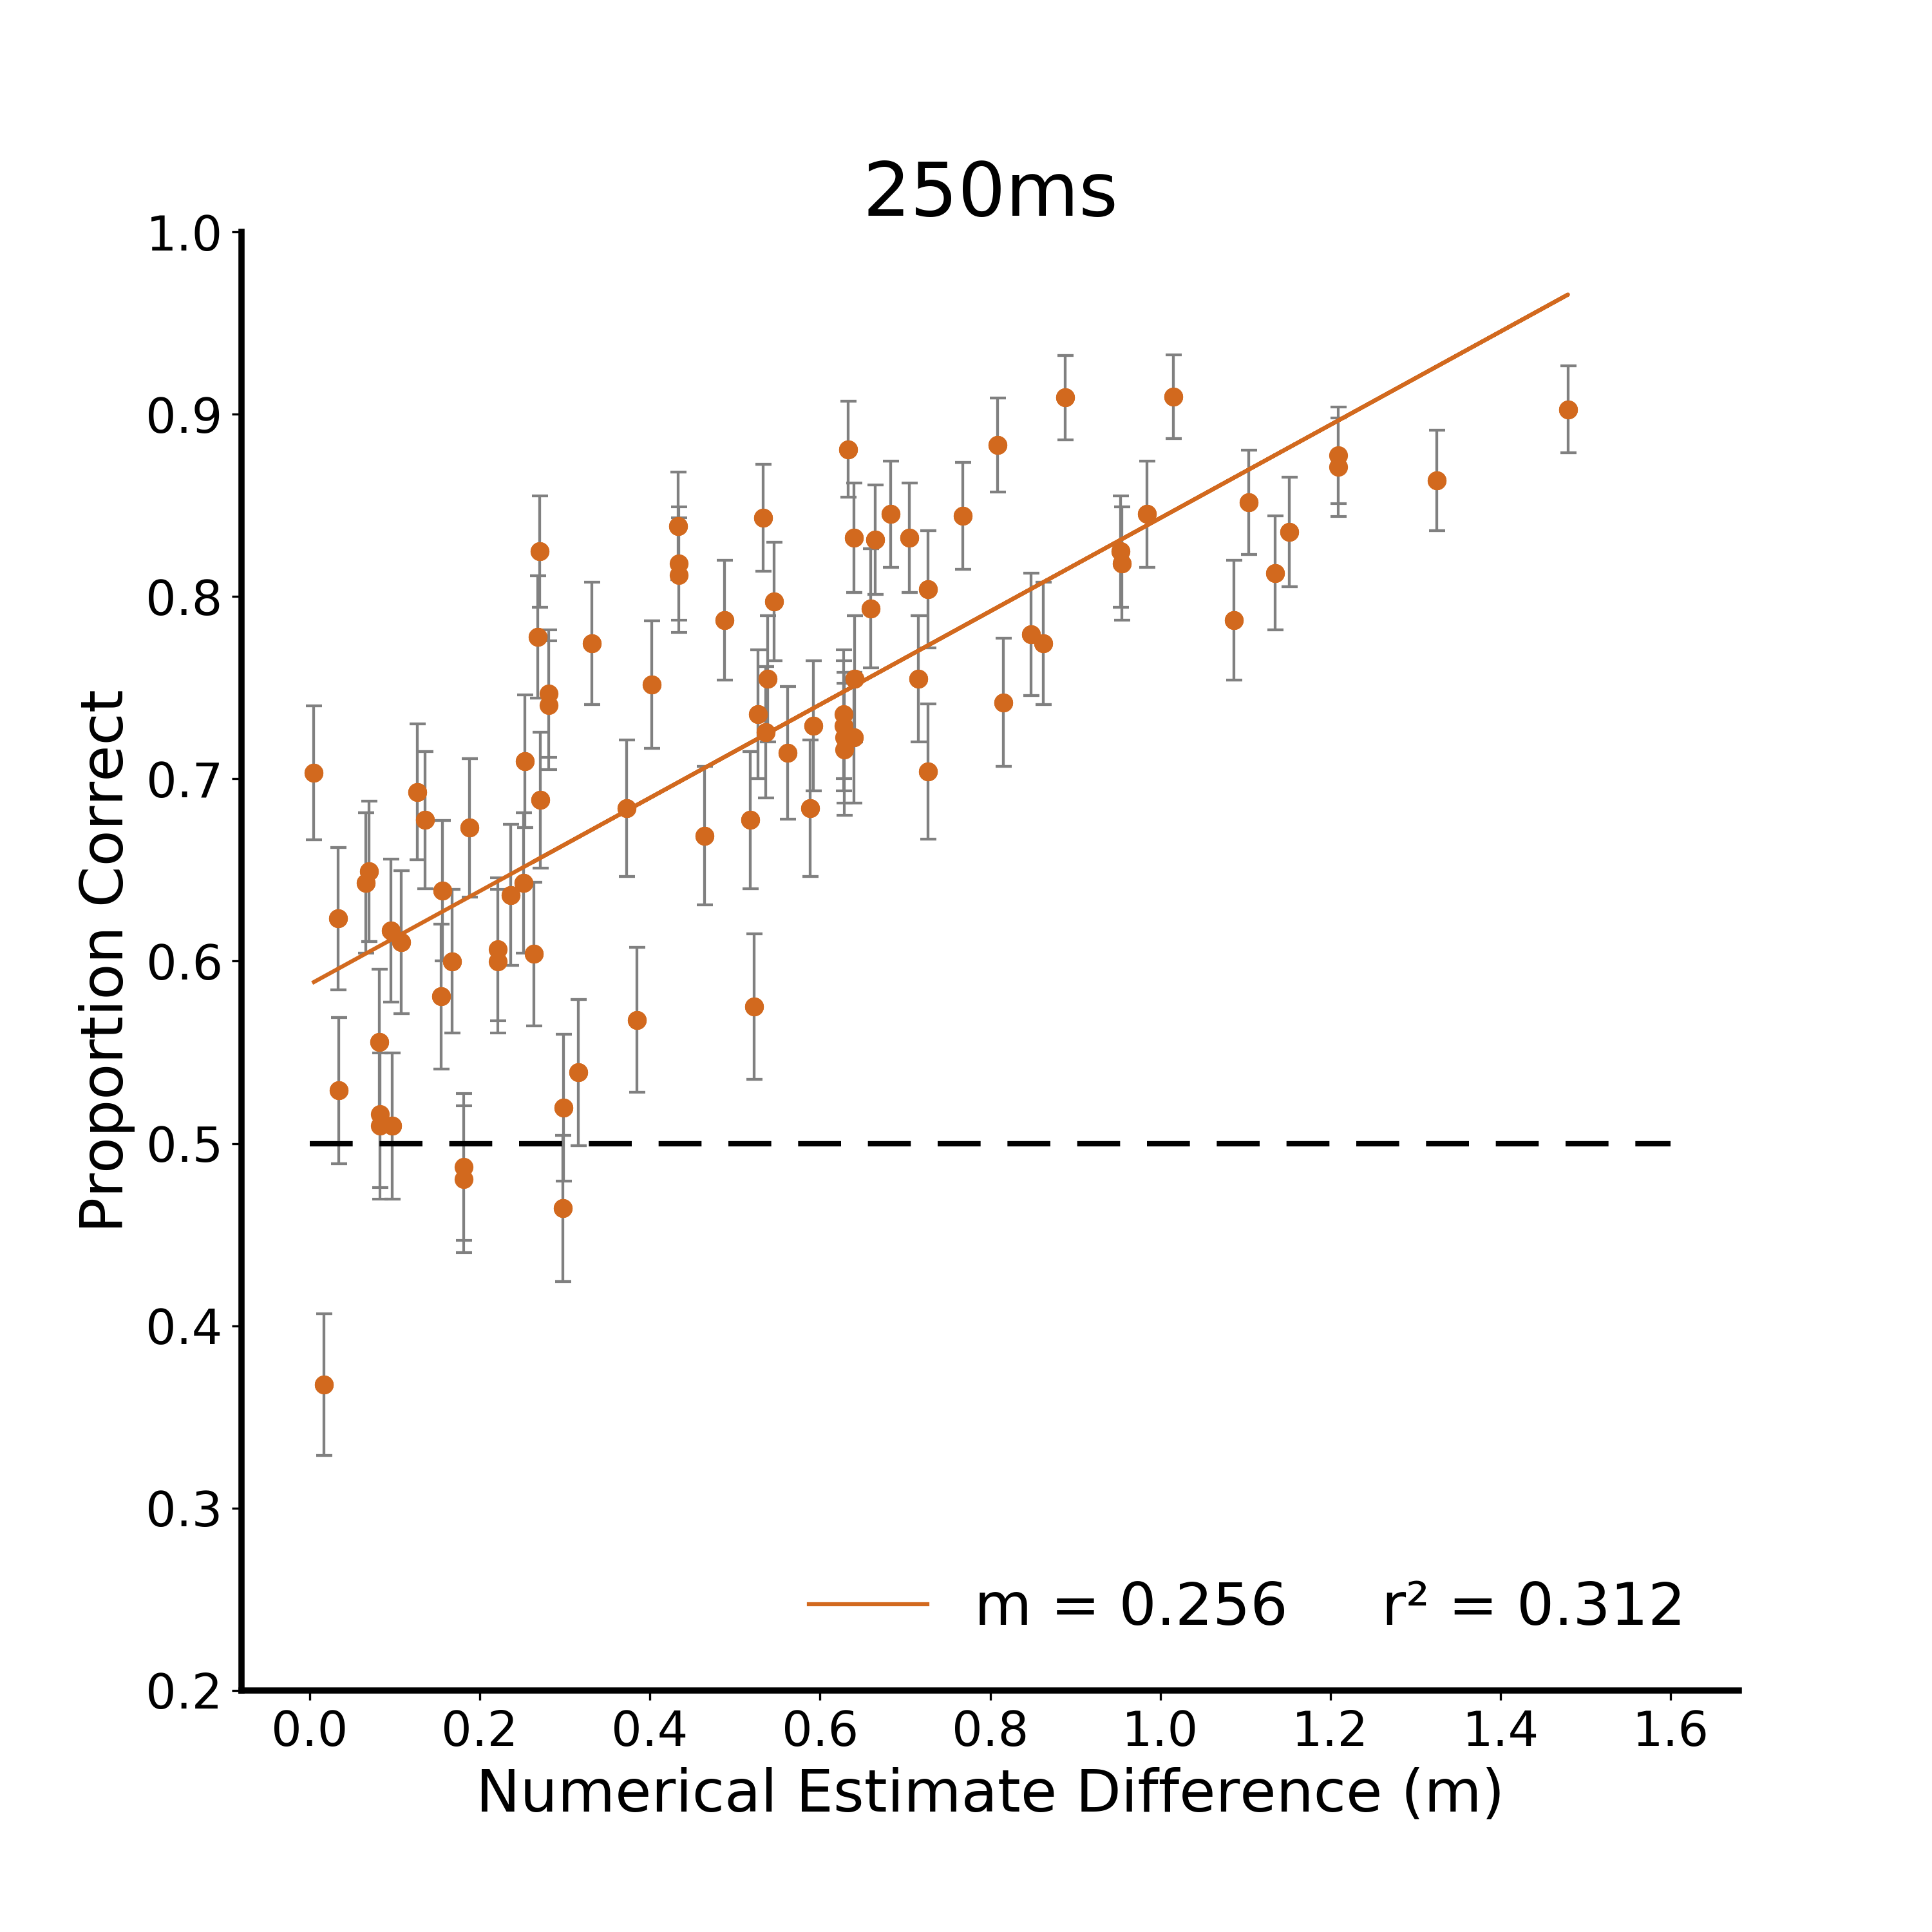
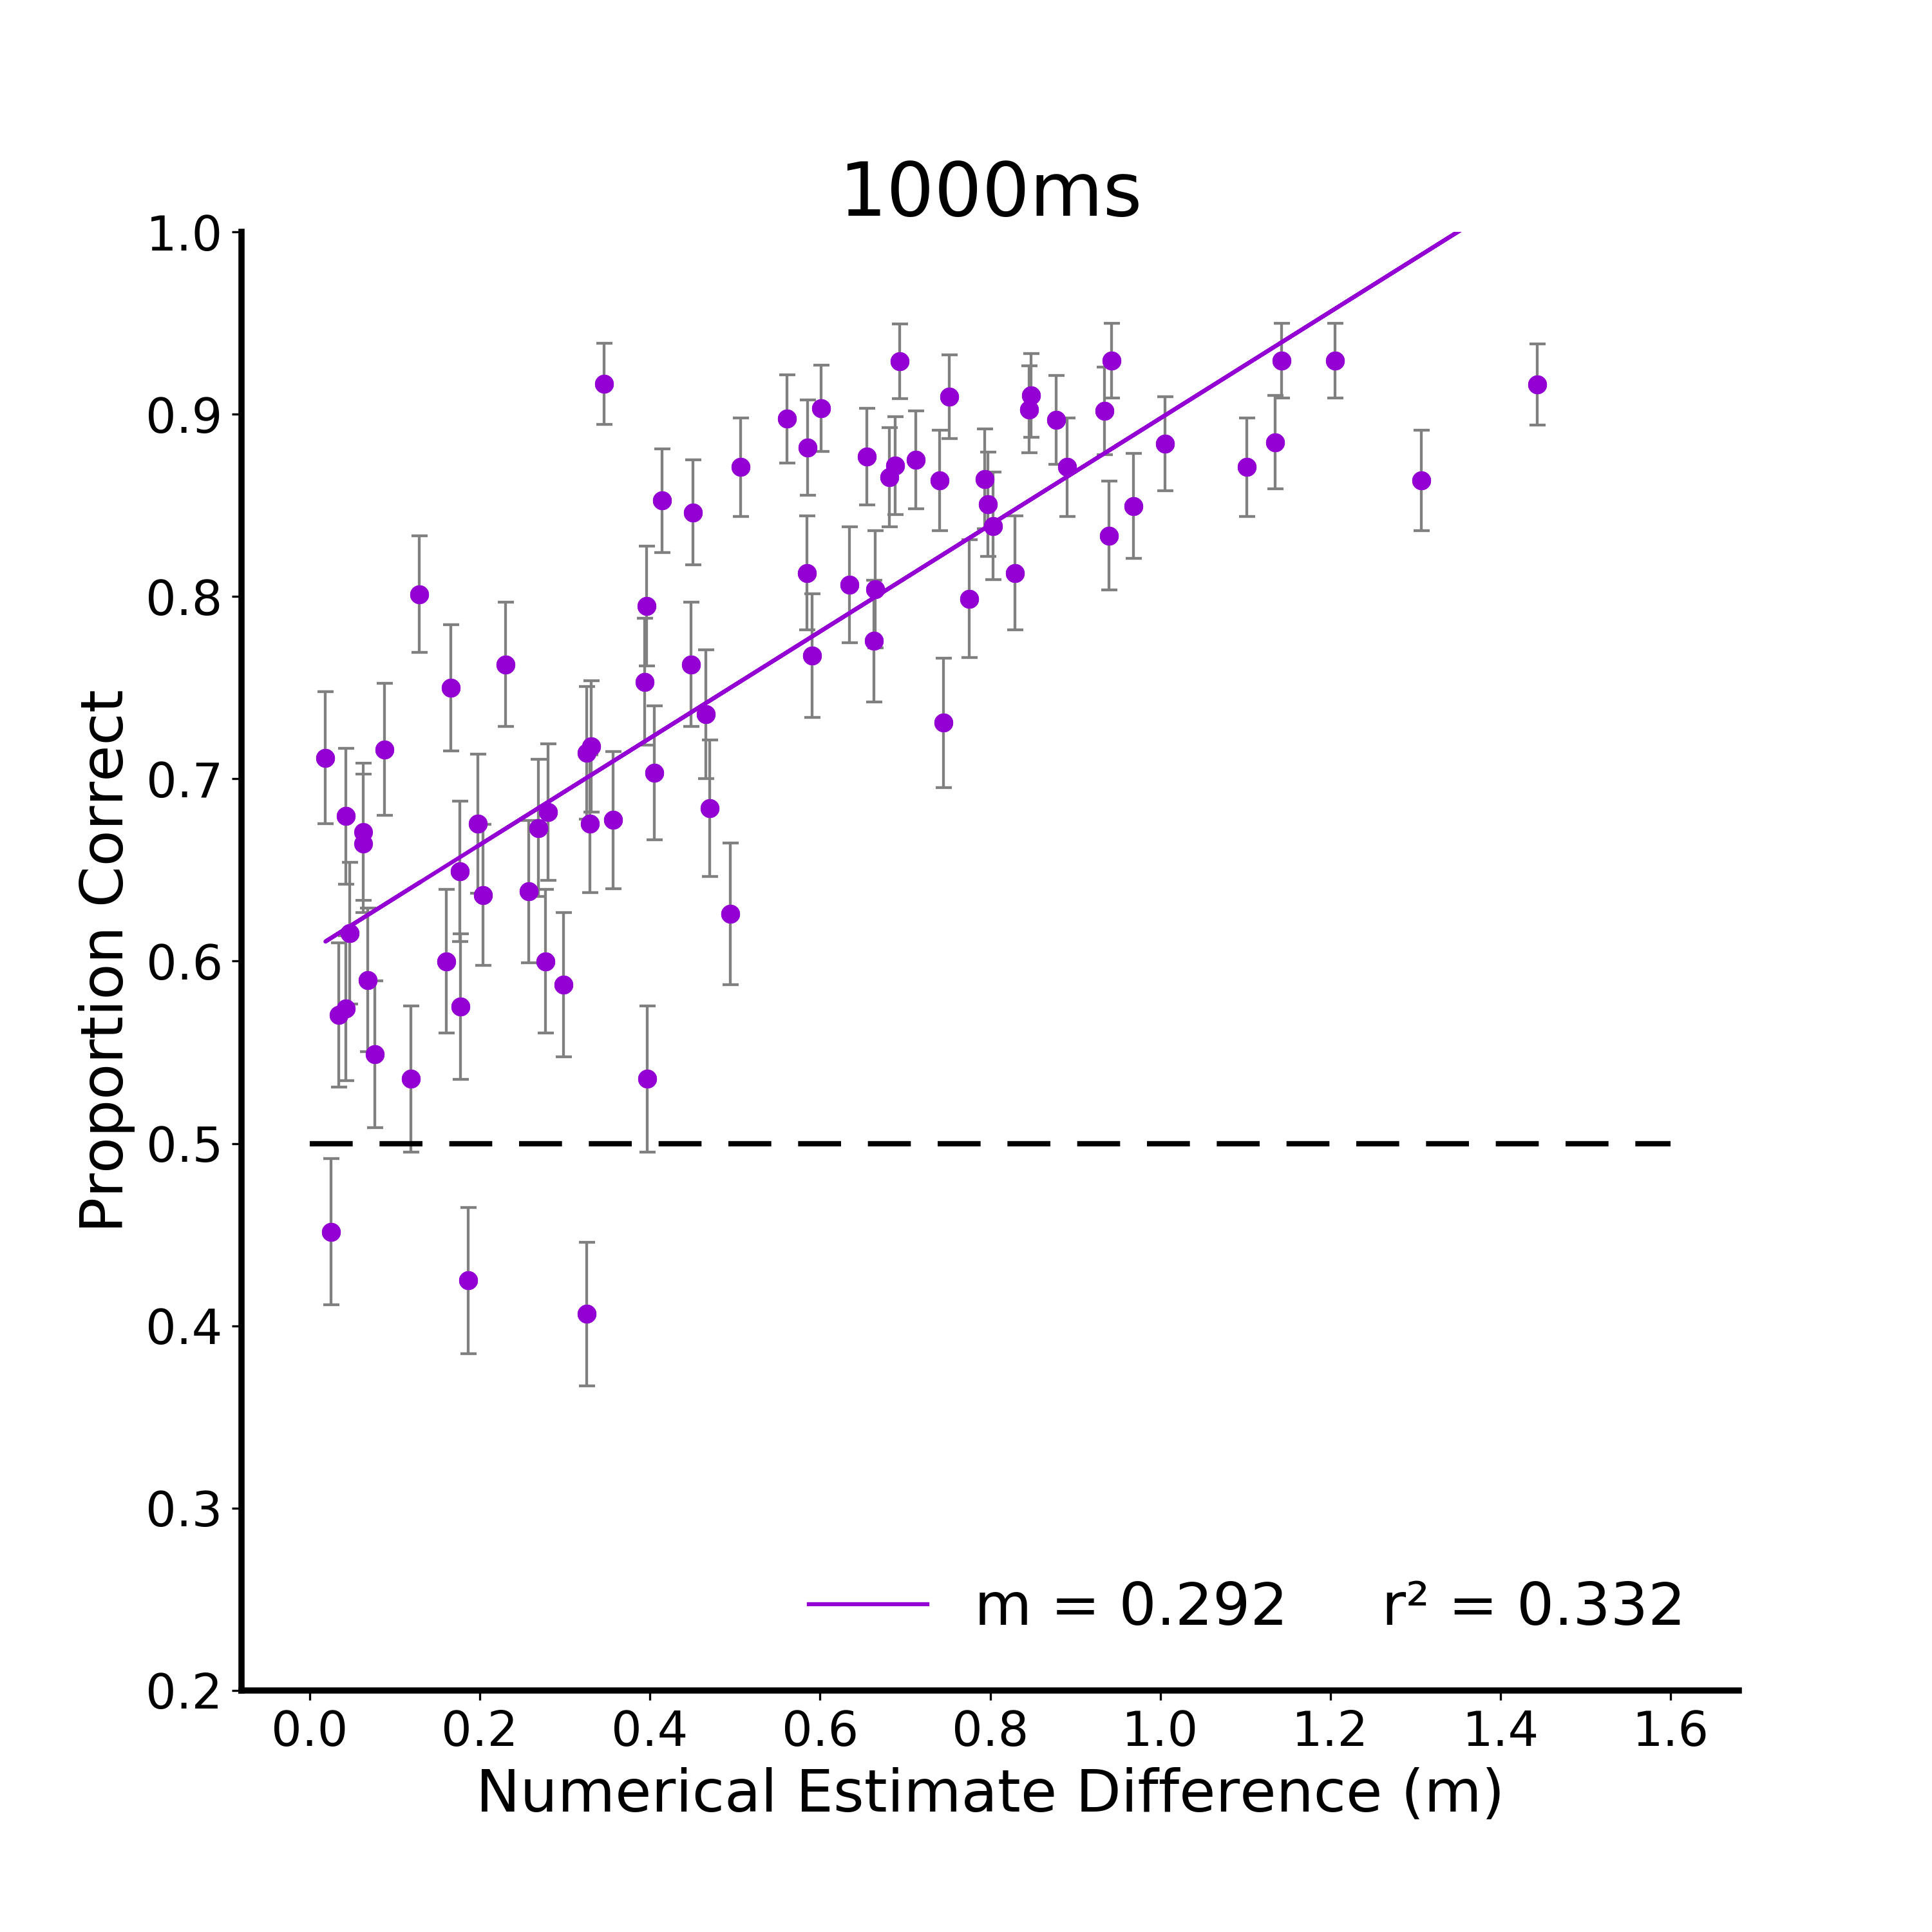
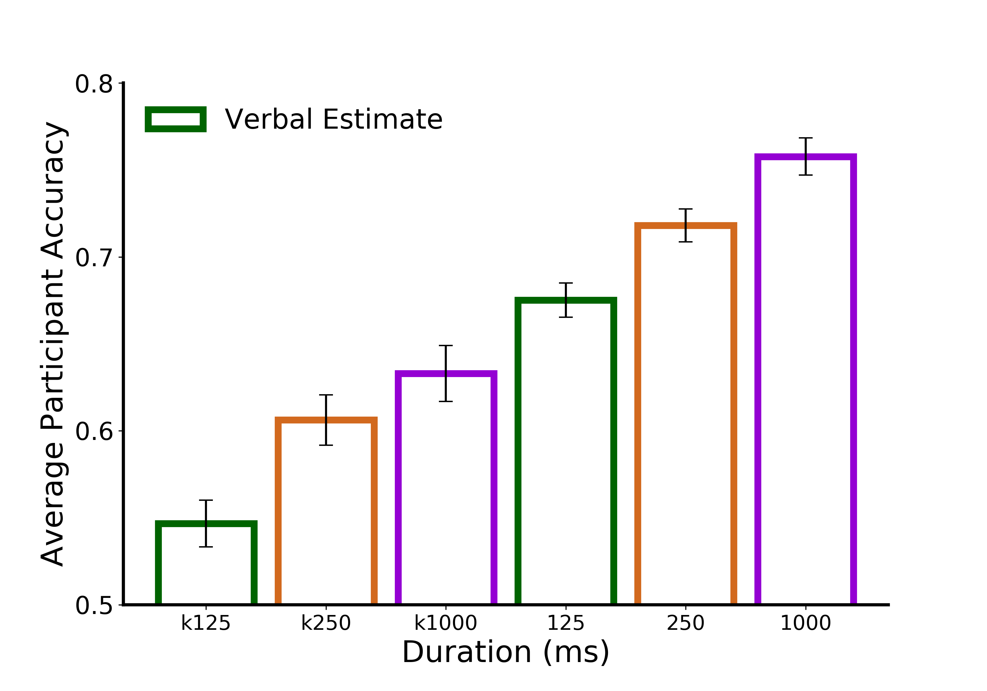
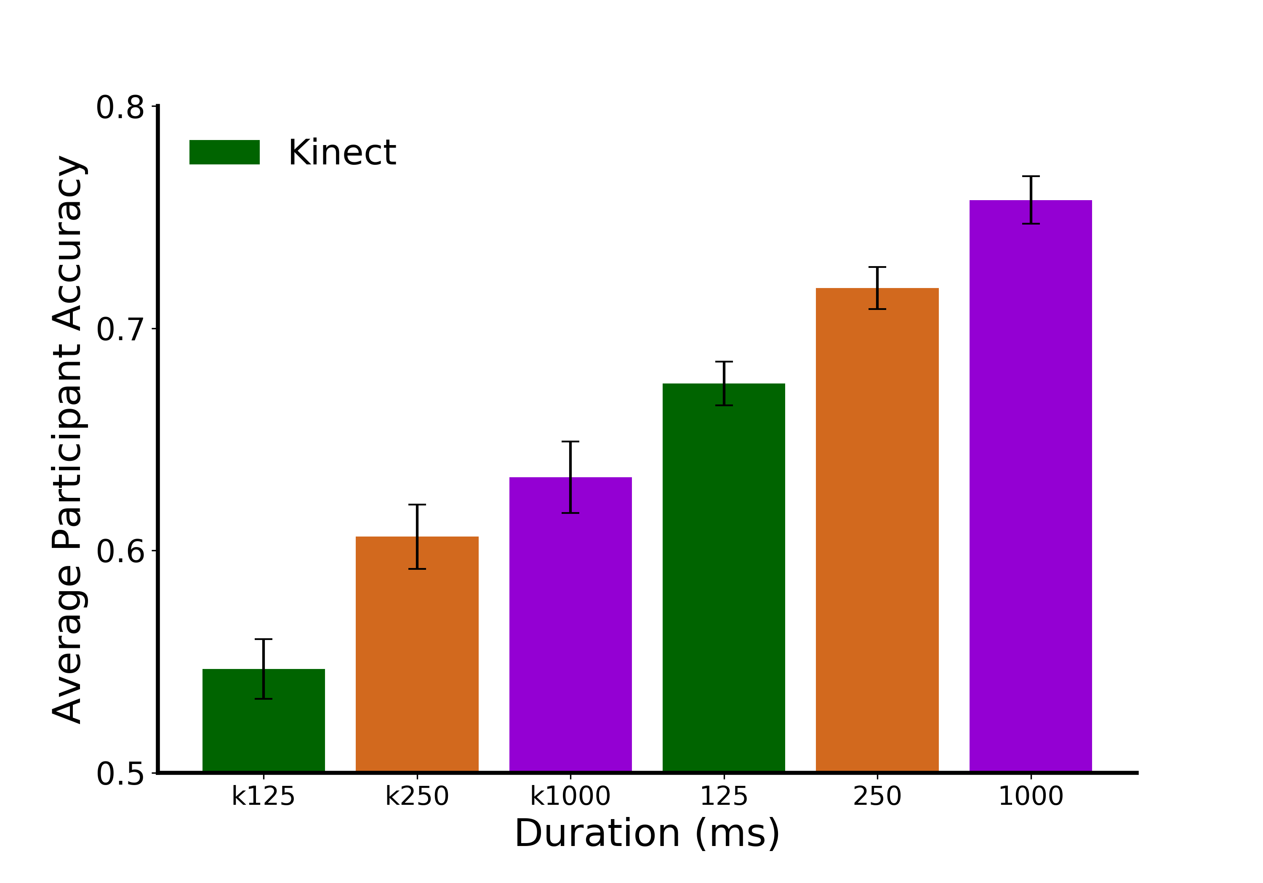
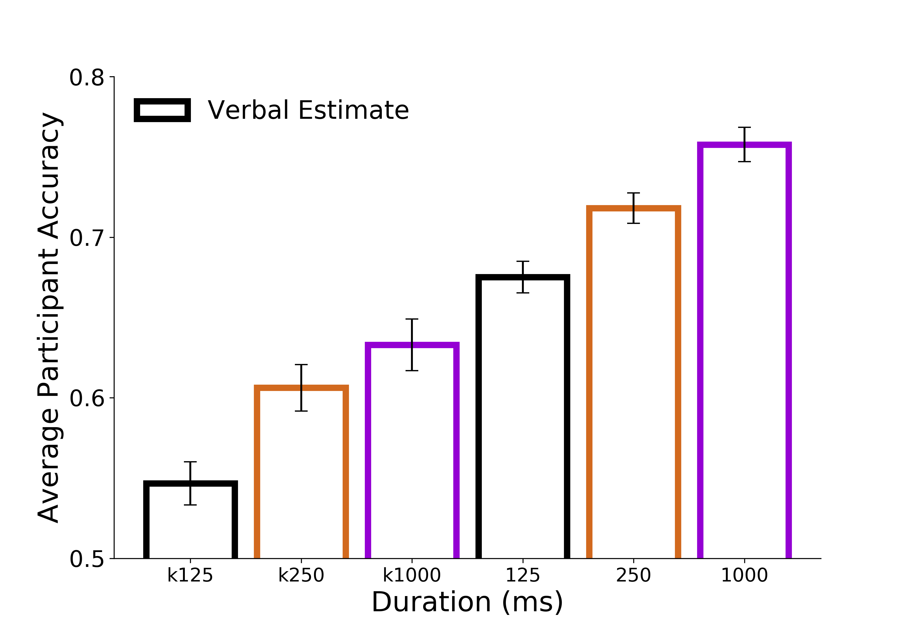
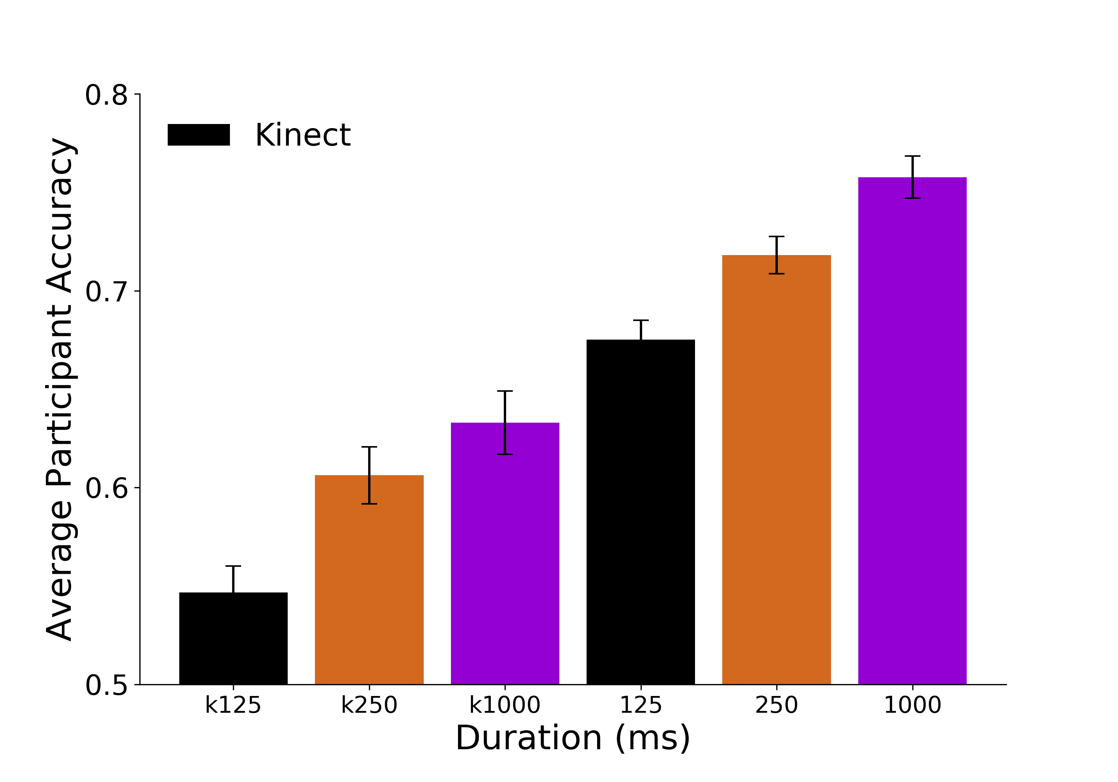
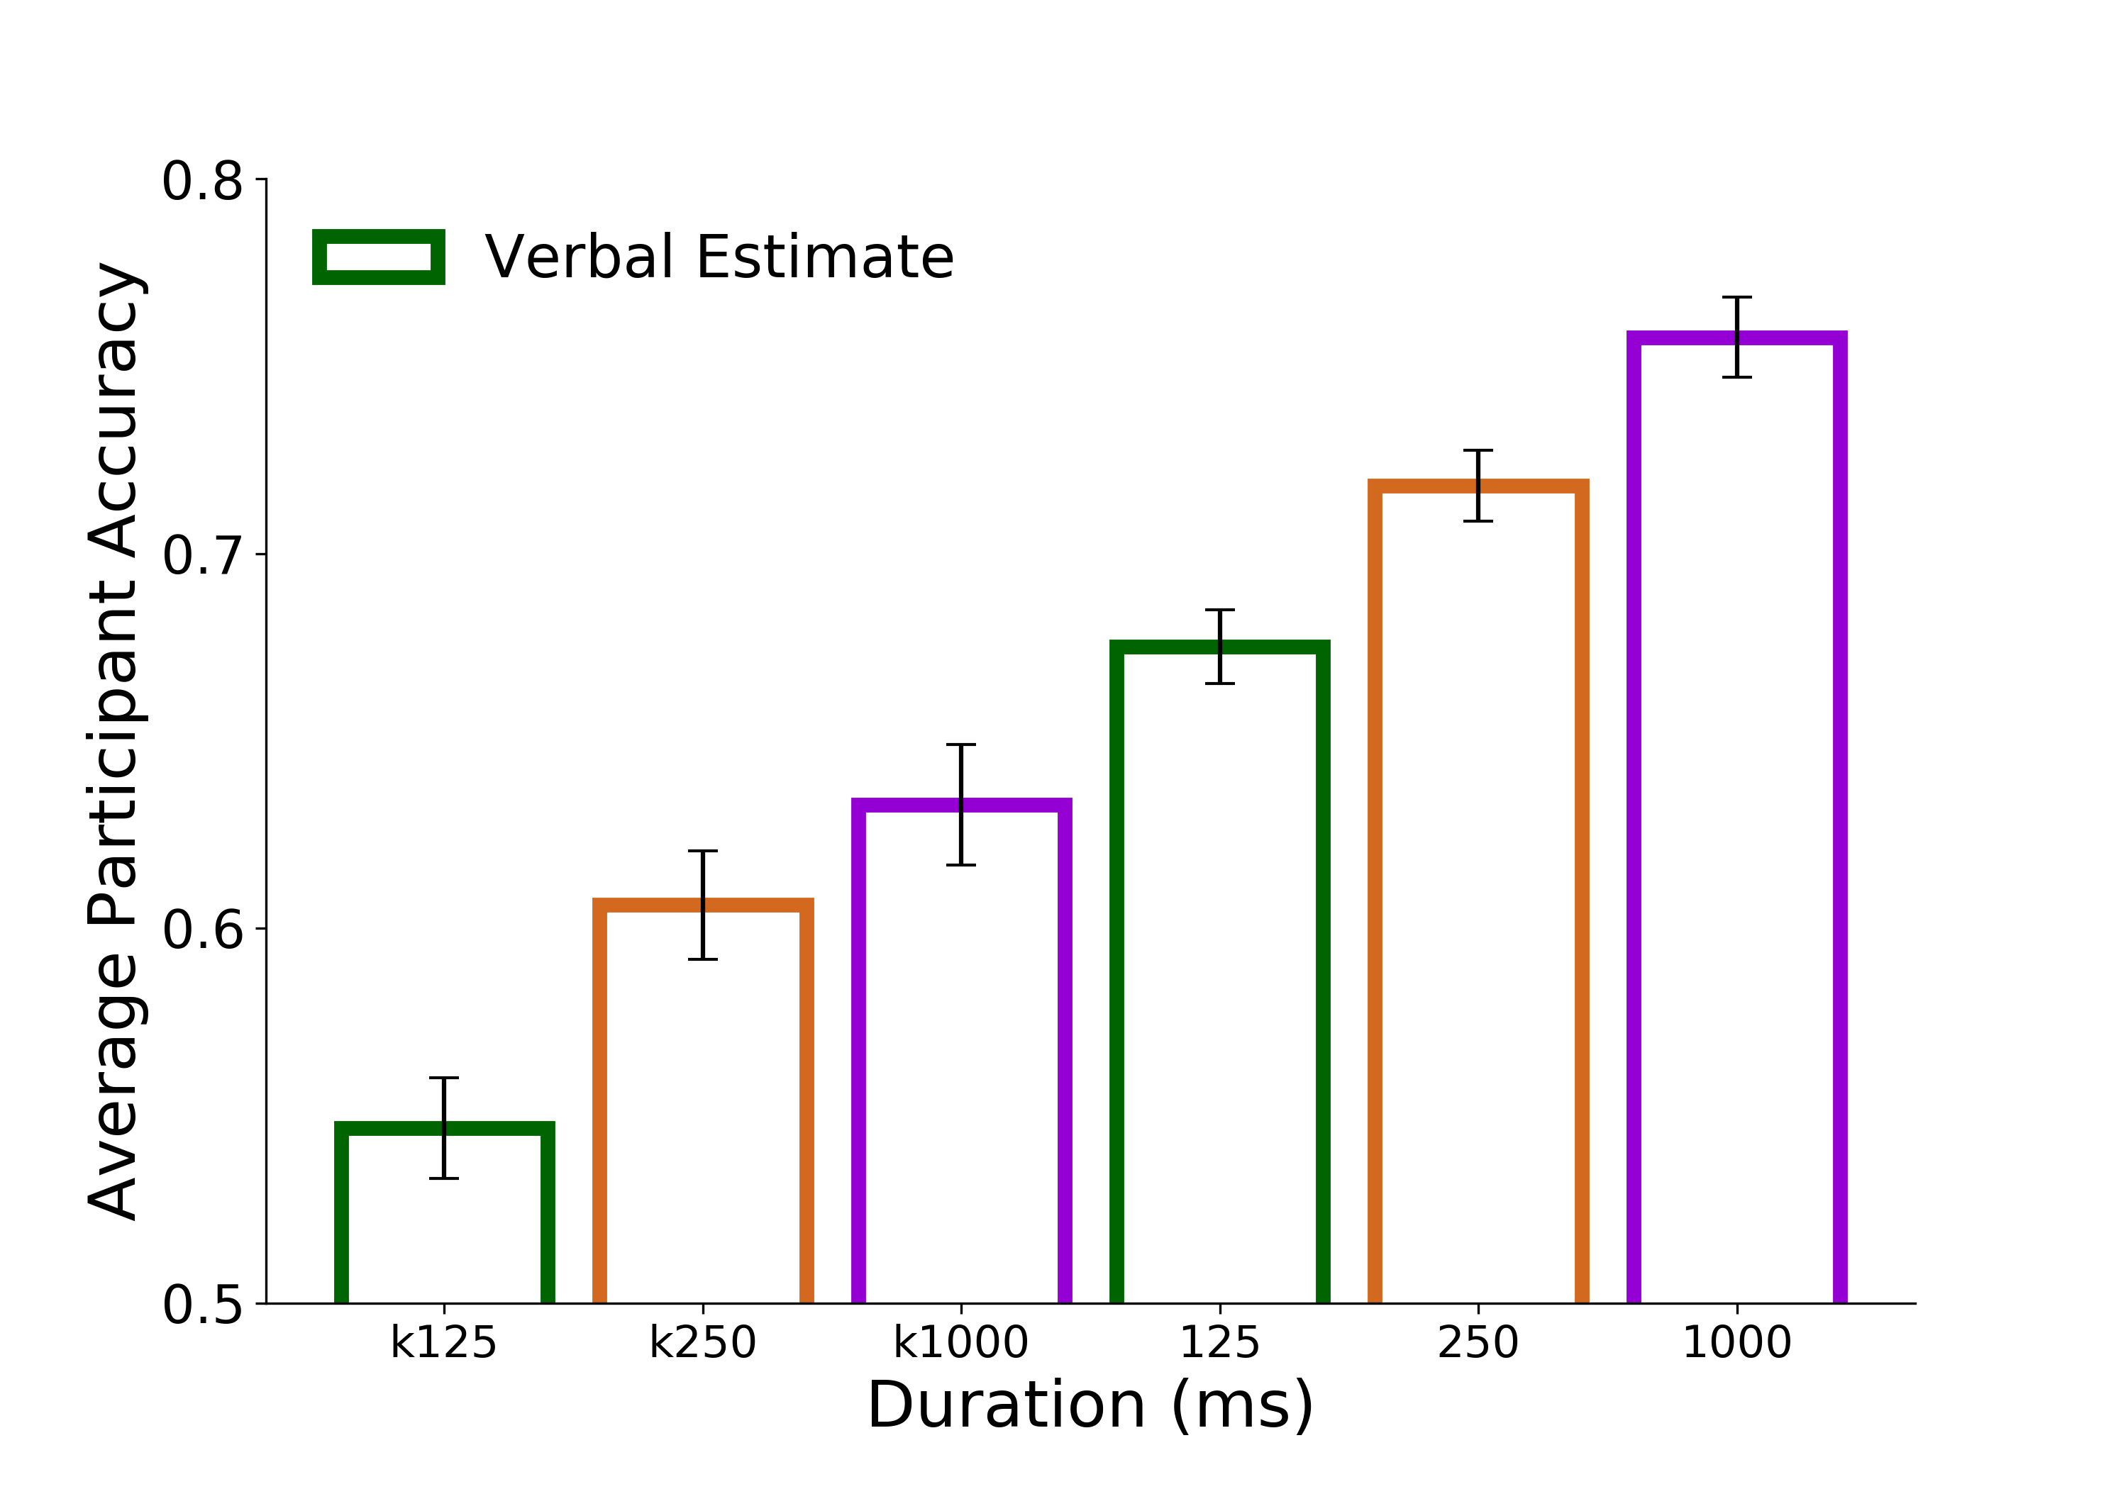
A.
B.
C.
D.
E.
Figure 6. Discrimination Accuracy Results. A) Linear model of discrimination accuracy as a function of the Kinect depth difference between targets for the 125ms viewing duration condition. B) Linear models of discrimination accuracy as a function of metric estimates from independent participants at 125ms. The metric estimate difference is calculated as the absolute difference between metric estimates for images within a discrimination trial. The metric estimate and discrimination task were comprised of independent groups of participants. C) Accuracy as a function of metric estimates at 250ms D) Accuracy as a function of metric estimates at 1000ms D) Discrimination accuracy as a function of the Kinect (bars with colored outline) and as a function of differences in metric estimates from independent participants (* indicates p<0.05; ** p<0.005; *** p<0.0005)
***
*
**
***

Slide 11
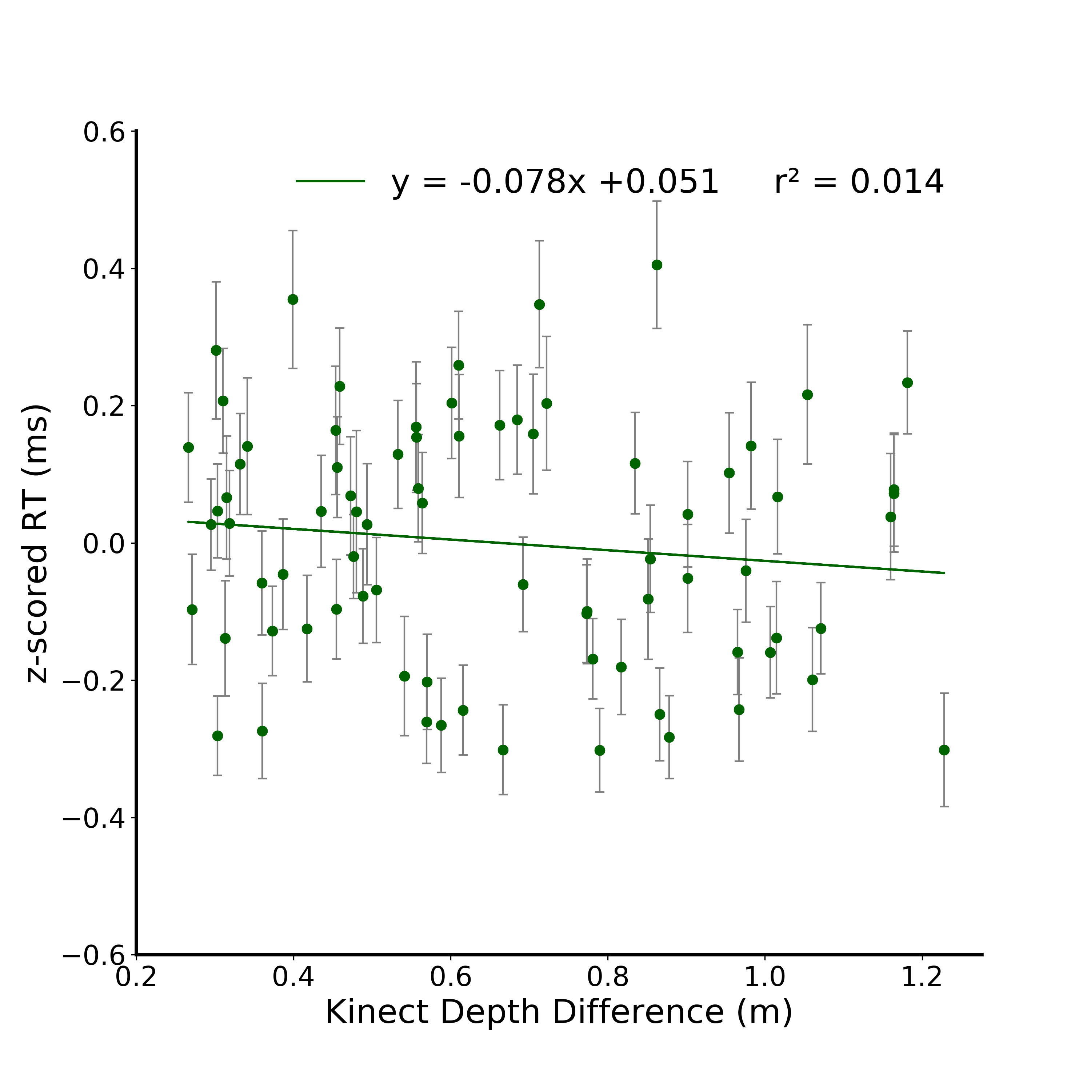
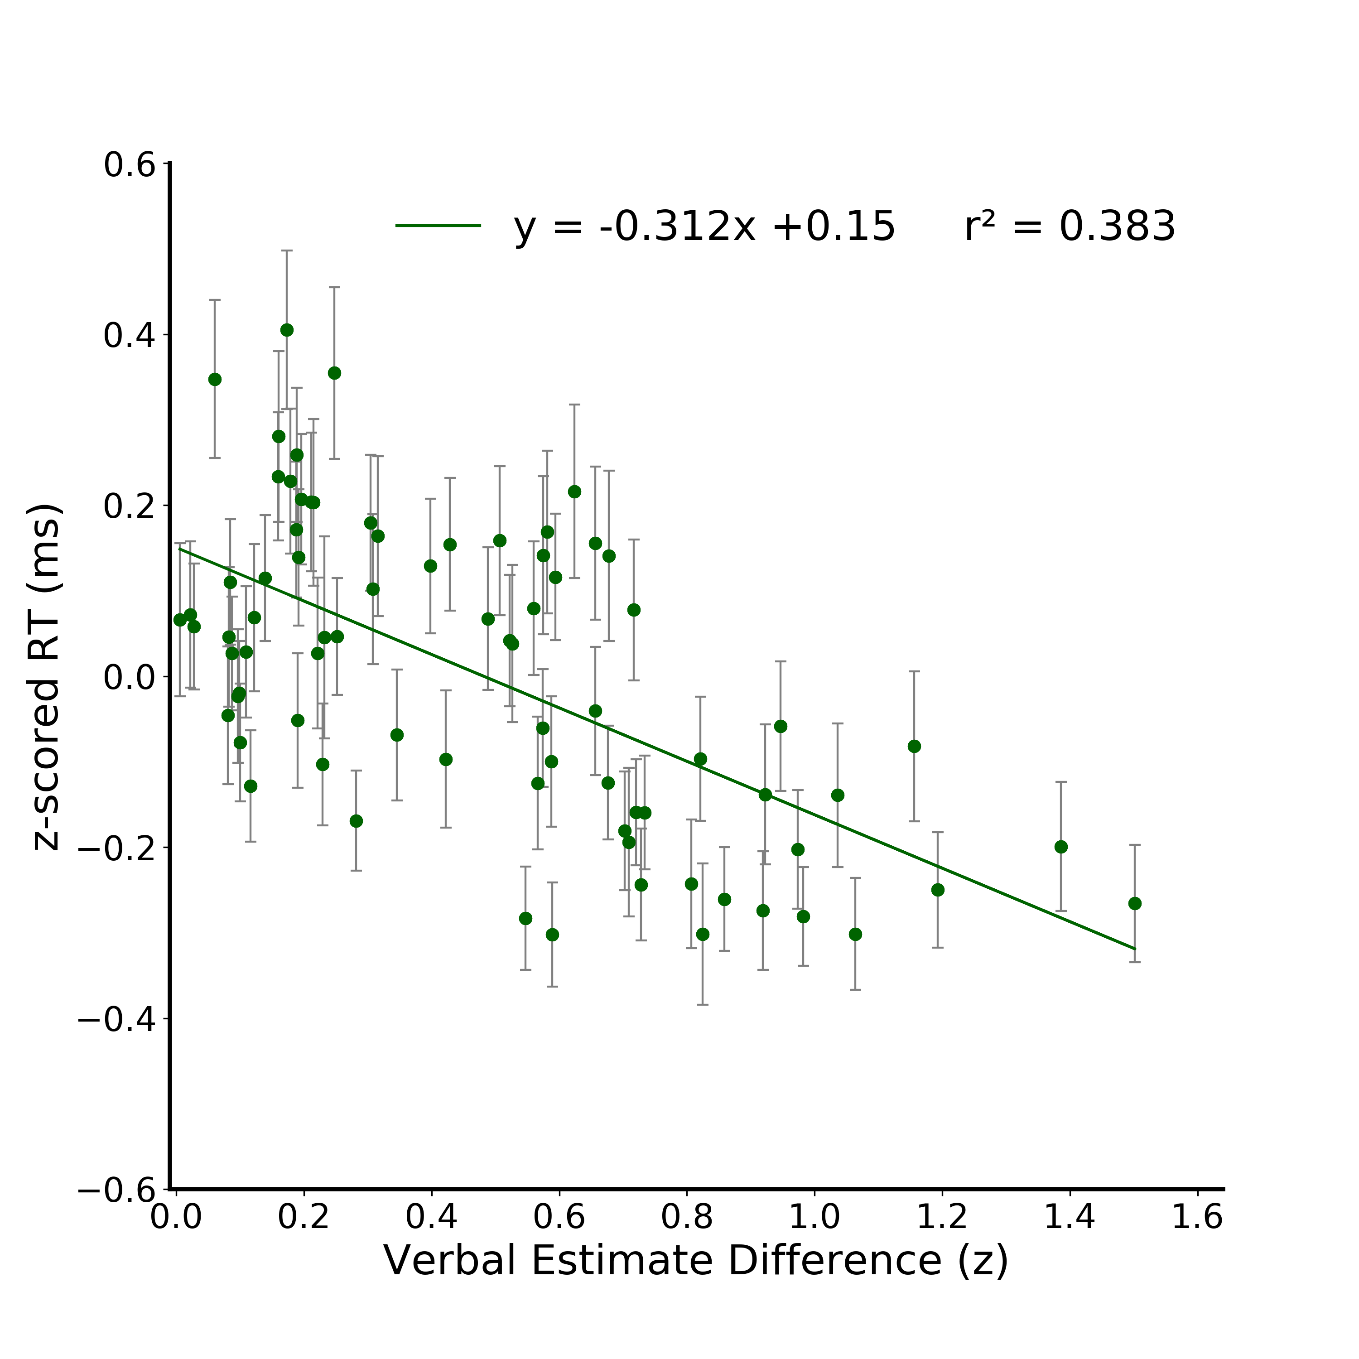


A.
B.
C.
D.
Figure 6. Discrimination Accuracy Results. A) Linear model of discrimination accuracy as a function of the Kinect depth difference between targets for the 125ms viewing duration condition. B) Linear models of discrimination accuracy as a function of verbal estimates from independent participants at 125ms. The verbal estimate difference is calculated as the absolute difference between verbal estimates for images within a discrimination trial divided by their joint variance, effectively resulting in a z-score of the verbal estimate difference. The verbal estimate and discrimination task were comprised of independent groups of participants. C) Accuracy as a function of verbal estimates at 250ms D) Accuracy as a function of verbal estimates at 1000ms D) Discrimination accuracy as a function of the Kinect (bars with colored outline) and as a function of differences in verbal estimates from independent participants (* indicates p<0.05; ** p<0.005; *** p<0.0005)
Figure 7. Discrimination Response Time Results. A) Linear model of discrimination response time as a function of the Kinect depth difference between targets for the 125ms viewing duration condition. B) Linear model of discrimination response time as a function of verbal estimates from independent participants at 125ms. The verbal estimate difference is calculated as the absolute difference between verbal estimates for images within a discrimination trial divided by their joint variance, effectively resulting in a z-score of the verbal estimate difference. The verbal estimate and discrimination task were comprised of independent groups of participants. C) 250ms and D) 1000ms

Slide 12










A.
Figure 7. Discrimination Response Time Results. A) Linear model of discrimination response time as a function of the Kinect depth difference between targets for the 125ms viewing duration condition. B) Linear model of z-scored response time as a function of the Kinect depth difference between targets for the 125ms viewing duration condition C) Linear model of z-scored response time as a function of metric estimates from independent participants at 125ms. The metric estimate difference is calculated as the absolute difference between metric estimates for images within a discrimination trial The metric estimate and discrimination task were comprised of independent groups of participants. D) 250ms and E) 1000ms
B.
C.
D.
E.

Slide 13

Discrimination split matrix
125
0.8
Percent Correct
250
0.4
1000
*
0.16
Correlation
0
*
125
- 0.16
- 0.4
Response Time
250
1000
- 0.8
125
250
1000
125
250
1000
Percent Correct
Response Time
Figure 8. Discrimination Average Correlation Matrix. Data were randomly split in half and correlated against itself. This was repeated 10,000 times resulting in this average correlation matrix. Given a sample size of 156 images and a significance level of 0.05, r >= 0.16 are significant. Within task outcome correlations are significant within and between viewing durations, demonstrating strong reliability between independent groups of participants. Significant correlations between task outcome (response time, percent correct) and viewing durations were also observed, indicating stimulus-level generalization.
Notes:
DONE

Slide 14
125
0.8
Percent Correct
250
0.4
1000
0.16
*
Correlation
0
125
- 0.16
*
Response Time
- 0.4
250
1000
- 0.8
125
250
1000
125
250
1000
Percent Correct
Response Time
Figure 8. Discrimination Average Correlation Matrix. Data were randomly split in half and correlated against itself. This was repeated 10,000 times resulting in this average correlation matrix. Given a sample size of 156 images and a significance level of 0.05, r >= 0.16 are significant. Within task outcome correlations are significant within and between viewing durations, demonstrating strong reliability between independent groups of participants. Significant correlations between task outcome (response time, percent correct) and viewing durations were also observed, indicating stimulus-level generalization.
Notes:
DONE
Within duration cmparisonas are stronger than between

Slide 15


125
Discrimination
0.8
0.8
250
1000
Percent Correct
125
0.4
0.4
250
Verbal Estimate
*
0.16
0.16
1000
Correlation
0.0
0
125
*
- 0.16
- 0.16
250
Discrimination
1000
- 0.4
- 0.4
Response Time
125
250
Verbal Estimate
- 0.8
- 0.8
1000
125
250
1000
125
250
1000
125
250
1000
125
250
1000
Discrimination
Verbal Estimate
Discrimination
Verbal Estimate
Percent Correct
Response Time
Figure 6. Average Correlation Matrix (Task x Outcome Measure x Viewing Duration). XX 5,000 on each side
Explain significance tests…
Notes:
Discrimination decoding analysis
-RT
VE is diff from discrim
Is the interreliabilty between discrim PC 125 x Discrim PC 125
Fix the order of the conditions so that across the diagonals it’s the same comparisons and average matrix across the diagonal
Within duration across task comparison

Slide 16

125
0.8
250
Percent Correct
0.4
1000
*
0.16
Verbal Estimate
Correlation
0
125
*
- 0.16
250
- 0.4
Response Time
1000
- 0.8
125
250
1000
125
250
1000
Percent Correct
Response Time
Discrimination
Figure 9. Average Correlation Matrix (Task x Outcome Measure x Viewing Duration). Data were randomly split in half and correlated against itself. This was repeated 10,000 times resulting in this average correlation matrix. Given a sample size of 156 images and a significance level of 0.05, r >= 0.16 are significant. This analysis was conducted in the ‘discrimination space’, meaning that comparisons between tasks were made in the context of a discrimination trial. Between task correlations are presented here. Significant correlations were observed in accuracy and response time between tasks (discrimination, verbal estimate) within and between viewing durations. Impressively, significant correlations were also found between tasks, outcome measure, and viewing duration (top right 3x3 matrix). These results indicate systematic errors and biases for individual stimuli between independent groups of participants.

Slide 17

125
0.8
250
Percent Correct
0.4
1000
0.16
*
Numerical Estimate
0
125
Correlation
- 0.16
*
250
- 0.4
Response Time
1000
- 0.8
125
250
1000
125
250
1000
Percent Correct
Response Time
Discrimination
Figure 9. Average Correlation Matrix (Task x Outcome Measure x Viewing Duration). Data were randomly split in half and correlated against itself. This was repeated 10,000 times resulting in this average correlation matrix. Given a sample size of 156 images and a significance level of 0.05, r >= 0.16 are significant. This analysis was conducted in the ‘discrimination space’, meaning that comparisons between tasks were made in the context of a discrimination trial. Between task correlations are presented here. Significant correlations were observed in accuracy and response time between tasks (discrimination, metric estimate) within and between viewing durations. Impressively, significant correlations were also found between tasks, outcome measure, and viewing duration (top right 3x3 matrix). These results indicate systematic errors and biases for individual stimuli between independent groups of participants.

Slide 18



N1
N2
POI
(x_{res}, y_{res}, depth)

Slide 19

A.
B.
2.64 m²
4.41 m²
(x_{res}, y_{res}, depth)
9.82 m²
1.76 m²
N1
N2
4.58 m²
POI
Visible ground plane: 7.95 m²
Complete ground plane: 13.247 m²
C.
D.
E.
Abs(Residuals) (z)
Residuals (z)
Residuals (z)
Complete Ground Plane (m²)
Complete Ground Plane (m²)
Complete Ground Plane (m²)
Figure 10. XX. A) Surface area for each pixel with the image (730x530 pixels) is calculated by first deriving its coordinates in 3D space as (x_{res}, y_{res}, depth) where x_{res} is the real-world width of the pixel and y_{res} is the real-world height of the pixel. Euclidean distance between the pixel of interest (POI) and its neighbors is calculated. The area of the triangles defined by the POI and its neighbors is subsequently calculated and summated across all pixels within an object. B) Sample output of the surface area algorithm. The polygon that subtends the complete ground plane (GP) is estimated using scene boundaries. The surface area of the visible ground plane (VGP) is calculated using the method described in A). Accordingly, the surface area of GP is equal to the proportion of pixels belonging to the visible vs. complete ground plane multiplied by the surface area of the VGP. C) Linear mixed effects model fits per viewing duration (125, 250, or 1000ms) where defined as such: Abs(residual) ~ groundPlane + duration + groundPlane*duration + (1|subjID) + (1|actual_depth), where the abs(residuals) reflect the residuals from the metric estimate linear models (Fig 3). Subject ID and the actual depth of the target were included as random effects. The surface area of the complete ground plane and duration were included as fixed effects. D) Linear mixed effects model fits per viewing duration defined with the same fixed and random effects as Fig 10C, but instead predicting only the positive residuals from the metric estimate linear models. E) Linear mixed effects model fits per viewing duration defined with the same fixed and random effects as Fig 10C, but instead predicting only the negative residuals from the metric estimate linear models.
Notes:
Make C D E narrower so that the xaxis are not crowded
Fix AB alignment
Finish figure text

Slide 20

A.
B.
2.64 m²
4.41 m²
(x_{res}, y_{res}, depth)
9.82 m²
1.76 m²
N1
N2
4.58 m²
POI
Visible ground plane: 7.95 m²
Complete ground plane: 13.247 m²
C.
D.
E.
Abs(Residuals) (z)
Residuals (z)
Residuals (z)
Complete Ground Plane (m²)
Complete Ground Plane (m²)
Complete Ground Plane (m²)
Figure 10. XX. A) Surface area for each pixel with the image (730x530 pixels) is calculated by first deriving its coordinates in 3D space as (x_{res}, y_{res}, depth) where x_{res} is the real-world width of the pixel and y_{res} is the real-world height of the pixel. Euclidean distance between the pixel of interest (POI) and its neighbors is calculated. The area of the triangles defined by the POI and its neighbors is subsequently calculated and summated across all pixels within an object. B) Sample output of the surface area algorithm. The polygon that subtends the complete ground plane (GP) is estimated using scene boundaries. The surface area of the visible ground plane (VGP) is calculated using the method described in A). Accordingly, the surface area of GP is equal to the proportion of pixels belonging to the visible vs. complete ground plane multiplied by the surface area of the VGP. C) Linear mixed effects model fits per viewing duration (125, 250, or 1000ms) where defined as such: Abs(residual) ~ groundPlane + duration + groundPlane*duration + (1|subjID) + (1|actual_depth), where the abs(residuals) reflect the residuals from the metric estimate linear models (Fig 3). Subject ID and the actual depth of the target were included as random effects. The surface area of the complete ground plane and duration were included as fixed effects. D) Linear mixed effects model fits per viewing duration defined with the same fixed and random effects as Fig 10C, but instead predicting only the positive residuals from the metric estimate linear models. E) Linear mixed effects model fits per viewing duration defined with the same fixed and random effects as Fig 10C, but instead predicting only the negative residuals from the metric estimate linear models.
Notes:
Make C D E narrower so that the xaxis are not crowded
Fix AB alignment
Finish figure text

Slide 21









A.
B.
Figure 11. Complete Ground Plane Linear Models. A) Absolute value of the residuals from the verbal estimate linear models against the complete ground plane surface area for each stimulus (plotted for each viewing duration - 125, 250, and 1000 ms). Residuals that were originally positive are plotted as open circles. Originally negative residuals are plotted as colored in circles. B) Directional residual linear models (i.e., positive and negative residual models) per viewing duration reveal a diverging effect within the residuals wherein the positive residuals increase, and the negative residuals decrease with larger complete ground plane values.
Notes:
DONE

